Slide 1
Concepts of Engineering and Technology
The Engineering Notebook
Technical Communication

Slide 3
Introduction
The purpose of this lesson is to define the Engineering Notebook and provide hints for maintaining your Engineering Notebook.
Each student is required to purchase and maintain an Engineering Notebook throughout this course.

Slide 4
Technical Communication
130.362.2 The student presents conclusions, research findings, and designs using a variety of media throughout the course. The student is expected to:
(B) Maintain a design and computation engineering notebook.

Slide 5
Technical Terms and Definitions
The terms and definitions listed below are discussed in this lesson. Please review before proceeding with this lesson.
Terms | Definitions
Notes | A record of something written down to assist the memory or for future reference.
Sketches | Rough designs, plans, or drafts, as of a product.
Ideas | A plan or purpose of action; intention; design.

Slide 6
Technical Terms and Definitions
The terms and definitions listed below are discussed in this lesson. Please review before proceeding with this lesson.
Terms | Definitions
Contacts | Communicative interactions are recorded in the Engineering Notebook (i.e., who, when and what was discussed).
Websites | The connected group of pages on the World Wide Web used to research the engineering idea and design.
Pictures | Visual representations or mental images of the engineering idea.

Slide 7
Technical Terms and Definitions
The terms and definitions listed below are discussed in this lesson. Please review before proceeding with this lesson.
Terms | Definitions
Research | Is the systematic process of collecting and analyzing information to increase our understanding of the engineering idea under study. It is the function of the researcher to contribute to the understanding of the engineering idea and to communicate that understanding to others.

Slide 8
What is the Engineering Notebook?
In industry, the Engineering Notebook is a legal document used by engineers to protect their ideas.
It serves as the first way a unique idea gains protection.
It protects the rights of the engineer of the idea before a patent, trademark or copyright is documented.

Slide 9
Engineers Will Record
For each idea, the engineer will record the who, what and when concerning the idea.

Slide 10
Who? - Engineering Notebook
The engineer records the names of everyone involved in the idea generation in the Engineering Notebook.

Slide 11
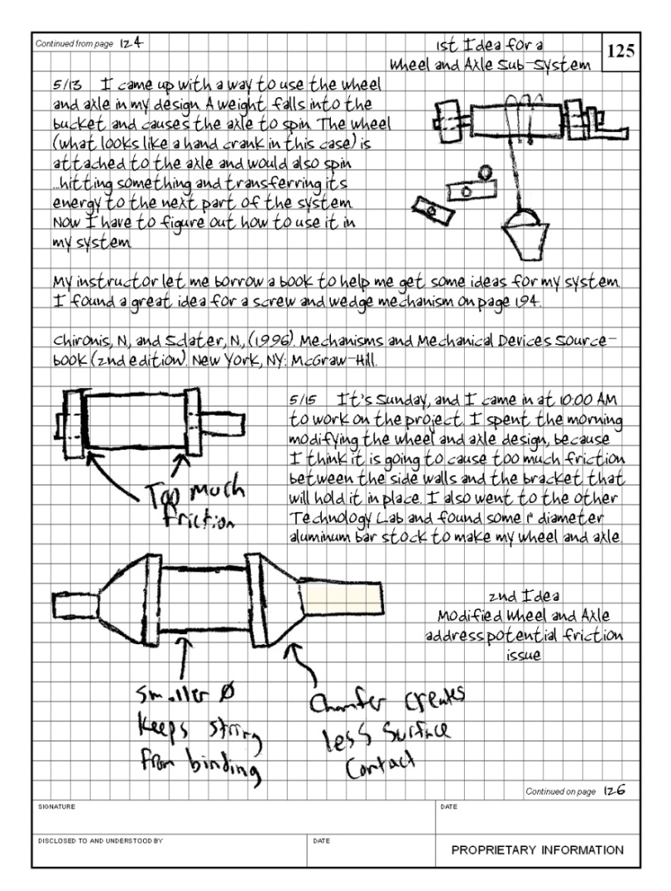
What? - Engineering Notebook
The Engineering Notebook contains:
Notes
Sketches
Ideas
Contacts
(who, when and what was discussed)
Websites
Pictures
Research information

Slide 12
When? – Engineering Notebook
The engineering records when the idea was first developed.
All pages in the Engineering Notebook are dated.
Information is clearly written and when the process began for the design is clearly illustrated.

Slide 13
Engineering Notebook - Standard Page Layout
Bound quadrille-lined (grid) pages.
Individually labeled page #s.
Location for designer’s signature and date.
Location for witness signature and date.
Locations for identifying contents as continued from and to another page.
Statement of the proprietary nature of the notebook.
Notes:
Note: Explain to the students where the information will go based on the notebook you are using.

Slide 14
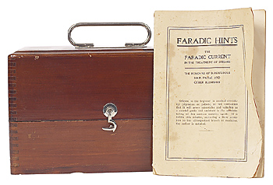
Engineering Notebook Hints
Create a Quick Reference Section in the Engineering Notebook. Use several pages in the front of the notebook as a table of contents for contact information (phone/e-mail).
Errors in the notebook may be corrected by documenting later a reference to the page the change in the material to correct the answer.

Slide 15
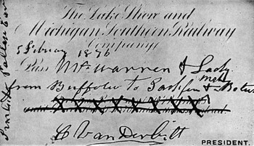
Engineering Notebook Hints
Entries start at the top of the page, working left-to-right and top-to-bottom.
Make sure all pages are initialed.
Changes or cross-outs need to be initialed each time a change is made.

Slide 16
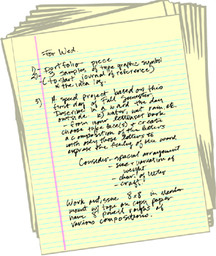
Engineering Notebook Hints
Never leave any blank pages in the engineering notebook.
Use both sides of the paper.
Place an X in areas that are not being used on a page.
No pages are removed from the Engineering Notebook for any reason.

Slide 17
Engineering Notebook Hints
The Engineering Notebook is stored in a safe location when it is not being used.
When the Engineering Notebook is full, a new one begins and picks up where other ended. Archive the old Engineering Notebook.
All entries, figures and calculations are clearly labeled.

Slide 18
Engineering Notebook Hints
Never backdate or change any designs already in your Engineering Notebook.
In industry, designers and engineers use ink in the Engineering Notebook, so that ideas cannot be changed.
MARKERS that bleed through the paper are NOT USED.

Slide 19
Rubrics for Grading the Engineering Notebook
Engineering Notebooks should follow the hints listed in today’s presentation and will be graded as follows:
Levels of Assessment | Interpretation of Level
4 - Excellent | Exceeds engineering notebook guidelines.
3 - Good | Meeting engineering guidelines. No need for additional assistance at this time, although some areas as indicated, could be improved.

Slide 20
Rubrics for Grading the Engineering Notebook
Engineering Notebooks should follow the hints listed in today’s presentation and will be graded as follows:
Levels of Assessment | Interpretation of Level
2 – Needs Improvement | Falls below engineering notebook guidelines. Demonstrates limited effectiveness, additional assistance and/or resource utilization is needed for improvement.

Slide 21
Rubrics for Grading the Engineering Notebook
Engineering Notebooks should follow the hints listed in today’s presentation and will be graded as follows:
Levels of Assessment | Interpretation of Level
1- Not Effective | A great deal of assistance and/or resource utilization are of immediate need.
N/A | Does not apply to the engineering notebook guidelines being reviewed.

Slide 22
Assignment: The Engineering Notebook
Discuss the type of Engineering Notebook your class will use.
Ask any questions you may have concerning the Engineering Notebook Hints and Grading Rubrics.
Purchase the Engineering Notebook.
Each week your teacher will randomly select Engineering Notebooks for grading.
Remember to make sure your Engineering Notebook is updated daily.

Slide 23
References
Define.com http://define.com
ClipArt http://www.clipart.com/en/
Microsoft Bing.com Research http://bing.com

