Slide 1
The Underwriting Process
Banking and Financial Services

Slide 3
What is Underwriting?
The process that a lending institution uses to determine if a customer is eligible for its products or services
Loose, or lax, underwriting contributed to the 2008 recession
Ability-to-Repay Rule
Adopted by the Consumer Finance Protection Bureau
Includes provisions from the Dodd Frank Act of 2010
Includes requirements that lenders must follow when making loans that consider in detail the borrower’s ability to repay a loan
Notes:
A lender wants to ensure that its interest is protected, so there are steps to assess if customers are eligible for its products or services.

Slide 4
Purposes for Underwriting
Tries to predict the reliability of a borrower or customer
Products and services requiring the underwriting process:
Credit, such as credit cards
Mortgage
Insurance
Capital requests, as in financing for a business
Renting property or furniture
Notes:
Aside from applying for a loan, which is the most common need for underwriting, anyone who wants assurances to credit-worthiness may undergo the underwriting process. For example, applying for a credit card or insurance requires underwriting. A landlord may underwrite an application to see if you are a good risk. When a business wants to fund a capital expenditure, a lender may require underwriting as a step for approval.

Slide 5
Credit Process
Application
Documentation
Processing
Underwriting
Closing and Funding
Notes:
Today loans are not made solely on a handshake. There are steps to be followed such as application, documentation, processing, underwriting, and closing and funding.

Slide 6
Approval Process
Application
Completed by customer
Provide complete and accurate information
Documentation
Gathered by lending institution
Examples: credit report, appraisal (when necessary), bank account or verification of employment
Notes:
To begin, a potential borrower completes and submits an application. The required documentation is provided and processed. The underwriting process of verifying the validity of the documents as well as the borrower’s credit is completed, and if approved, the loan is closed and funded.

Slide 7
Approval Process
Processing
Compilation of a loan file
Loan officer examines for completeness
Underwriting
Evaluation of the four C’s of credit
Notes:
To begin, a potential borrower completes and submits an application. The required documentation is provided and processed. The underwriting process of verifying the validity of the documents as well as the borrower’s credit is completed, and if approved, the loan is closed and funded.

Slide 8
Closing and Funding
After the Underwriting process is approved and accepted is closing and funding (if review is for a loan):
Closing
All documentation is signed
Disclosure statements presented detailing all costs of loan
Funding
Either a check is issued or
A deposit is made into the customer’s account
Notes:
Now the loan can be “closed and funded.” Documents are signed and funds are transferred.

Slide 9
The Four C’s of Credit
Character
Cash (or Capital)
Collateral
Capacity
How much credit do you have?
Is your credit positive?
Do you have cash on hand for emergencies?
Do you only use credit?
Do you have assets?
Are they assets you could sell if necessary?
Are you employed?
Do you have means to make payments?
Notes:
There are typically several things that are evaluated to determine a borrower’s creditworthiness, or ability to repay a loan. Your character is basically if your credit is positive and how much of it you have. Cash, or capital, refers to if you have an emergency fund of cash or if you only use credit. Collateral is what you have that has value—could you sell anything to raise money if you needed cash? Capacity is your ability to pay—do you have a job or some source of income?

Slide 10
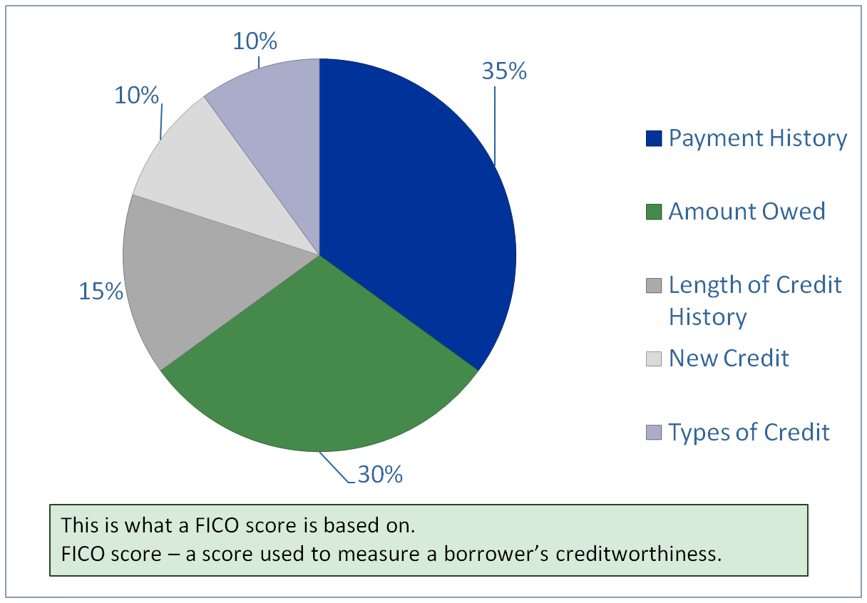
Individual Credit Approval
Notes:
Most lenders use a FICO score to assist in their underwriting. It can help quantify the credit-approval process. Typically the following percentages are used as a breakdown of the score: 35% for payment history, 30% for the total amount owed, 15% for length of credit history, 10% for new credit, and another 10% for types of credit.

Slide 11
FICO breakdown
FICO = Fair Isaac Credit Corporation
Payment History
How have you handled previous credit?
On time payments, missed payments
Amount Owed
The percent of amount owed compared to the limits
Notes:
A FICO score is a numerical representation of a person’s creditworthiness. It can be an effective indicator of a person’s ability to repay debt. It depends upon several factors, such as how you have previously handled credit, how much of your credit you have used, how long you have had credit, how much of it is new credit, and what kind of credit it is.

Slide 12
FICO breakdown
Length of Credit History
How long have you had credit?
New Credit
Have you recently obtained a lot of credit and are you applying for more?
Types of Credit
Is it mostly revolving such as credit cards, or installment loans such as a car payment?
Notes:
A FICO score is a numerical representation of a person’s creditworthiness. It can be an effective indicator of a person’s ability to repay debt. It depends upon several factors, such as how you have previously handled credit, how much of your credit you have used, how long you have had credit, how much of it is new credit, and what kind of credit it is.

Slide 13
Business Credit Approval
Balance Sheet
Looking at a company’s assets
Cash Flow
Money coming in and going out of a business
Collateral
Buildings, equipment, intellectual property among other capital
Debt Ratios – compare debt to income or assets
Notes:
Because a business is not typically one individual, its credit is usually assessed in a different way. Businesses also apply for loans for different reasons, such as to purchase equipment or expand the business. Its financial statements, such as the Balance Sheet and Cash Flow statement are effective indicators of its ability to repay. Does the business have collateral that can be sold if necessary? Does it have too much debt relative to its assets?

Slide 14
Debt Ratios
Debt-to-income = liabilities/assets
Debt-service-coverage = amount of debt payment/income
Loan-to-value = loan amount/ appraised value of property
Notes:
Debt ratios are especially important when considering the ability to repay a loan. Is there already too much debt, or liabilities, compared to the assets owned by the business? Are the current debt payments relatively low compared to the income? Is the loan amount being requested hopefully well under the value of the property that will be used as collateral?

Slide 15
Credit Approval
If accepted . . . can receive favorable interest rates if credit is reviewed for a loan and found to be positive
If accepted conditionally . . . subprime rates may apply, meaning higher than typical interest rates due to a borrower’s increased risk
If rejected . . . check with financial institution to see why denied, what areas need improvement and get a credit report
Notes:
Having credit approved can lead to a reasonable interest rate if your credit is favorable. Credit can also be approved conditionally, for example, with higher interest rates if the borrower is somewhat risky. If credit is denied you are supposed to be told why, by law, and then obtain a credit report.

Slide 16
Independent Practice Assignments
Loan Underwriter Career Assignment #1 – Students are to create a Venn diagram with two interlocking circles (large enough to fit quite a bit of information). Go to www.bls.gov, click on Publications, Occupational Outlook Handbook, then search for Loan Officer. In one circle the following sections should be included, with at least two items for each section: 1) what they do, 2) work environment, 3) how to become one, and 4) pay. Next, conduct Internet research to locate Loan Officer jobs. Decide on one, and type (or write) the information for that job in the other circle. There should be at least a few terms or phrases that are the same, or similar to, what is stated on the bls.gov site. Type or write the similar phrases in the middle of the two circles where they overlap.

Slide 17
Independent Practice Assignments
News Headline Assignment #2 – Divide students into groups of three to four, depending upon the class size. The teacher should print out several articles (researched online ahead of time)—enough for the number of groups to each receive one. Assign each group the news article related to credit reports or credit scores, or let them choose one. Have the students affix the article to a flipchart paper or poster, and have them each make notes about the important points in their article. They can then create a presentation demonstrating the knowledge they gained from their article. You can show the video from the fefe.arizona.edu web site to give the students an idea of how to start.

Slide 18
Independent Practice Assignments
Credit Report Analysis Assignment #3 – Students will conduct Internet research to locate images of credit reports and select one. Using the percent breakdown of the FICO score components, students are to calculate the percentages of each component using the image that they selected and assign a credit score for their sample, ranging from 300-850, with 850 being the highest. They are to print their sample. They will also write a short summary that includes their score, the percentages they calculated, and their justification for the score they assigned. The summary can take any form, whether it is typed or handwritten.

