Slide 1
Career Pathways

Slide 3
Objectives
Students will learn about the various Career Pathways models adopted by the federal government, explore a career of interest, research a college of choice, and choose companies of interest to work for after graduating from college.

Slide 4
What are Career Pathways?
Career Pathways is a workforce development strategy used in the United States of America to support workers’ transitions from education into and through the workforce.

Slide 5
What are the Career Pathways?
In the State of Texas, Career Pathways are offered through Career Clusters – Programs of Study in high school.
Each Career Cluster – Program of Study is aligned with post secondary/industry collaboration.

Slide 6
Career Pathways – Programs of Study
There are 16 Career Pathways - Programs of Study available in the State of Texas.
All states recognize Career Pathways - Programs of Study are designed to provide skills to students enrolled in Career and Technical Education (CTE) high school courses.

Slide 7
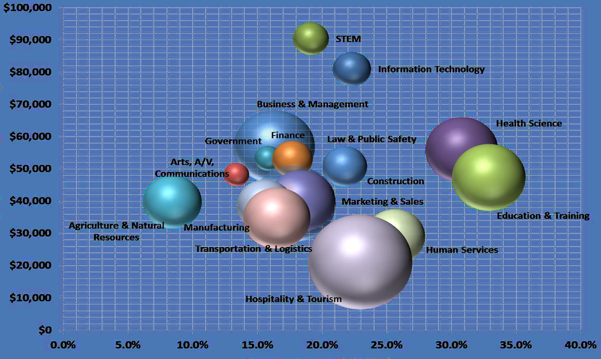
Career Pathways – Programs of Study

Slide 8
Career Pathway Research
Select a Career Pathway that you are interested in pursuing after graduation. Choosing a Career Pathway requires a lot of research and thought-provoking decisions.

Slide 9
Activity 1 - My Career Pathway
Complete the My Career Pathway handout.
1. Fill your name in the circle.
2. Make a list of your long-term goals.
3. List your interests.
4. Where do you want to live? List the city and state where you would like to live.
5. List at least eight preferred working conditions. For example, would you like to work on weekends or evenings?

Slide 10
Activity 1 - My Career Pathway
Complete the My Career Pathway handout.
6. List preferred environment (e.g., medical, education, etc.).
7. List preferred salary. How much money do you realistically expect to earn?
8. Select a Career Pathway – Program of Study that matches your interests and preferred salary.

Slide 11
Career Pathways Resources
There are several resources available to assist you with learning about the various Career Pathways. Please visit each website to learn more about each resource.
Bureau of Labor Statistics
http://www.bls.gov/ooh/
Department of Labor
http://www.dol.gov/
O-Net Online
https://www.onetonline.org/

Slide 12
Activity 2 - Career Pathway Presentation
Research and create a presentation about a career that you are interested in pursuing after graduation.
NOTE - Please use the Career Pathways Resources links to assist you with your presentation.

Slide 13
College or University of Choice
Research a college or university of interest that will assist you with pursuing your Career Pathway.
Create and deliver your research in a presentation.

Slide 14
Activity 3 - College or University Research
Research the college or university of your choice and produce a presentation.

Slide 15
Companies of Interest
Research 10 companies of interest that will assist you in pursuing your Career Pathway.
Create and deliver your research in a presentation.

Slide 16
Activity 4 - Companies of Interest Research
Research 10 companies of interest that will assist you in pursuing your Career Pathway.

