Slide 1
Careers in Manufacturing

Slide 3
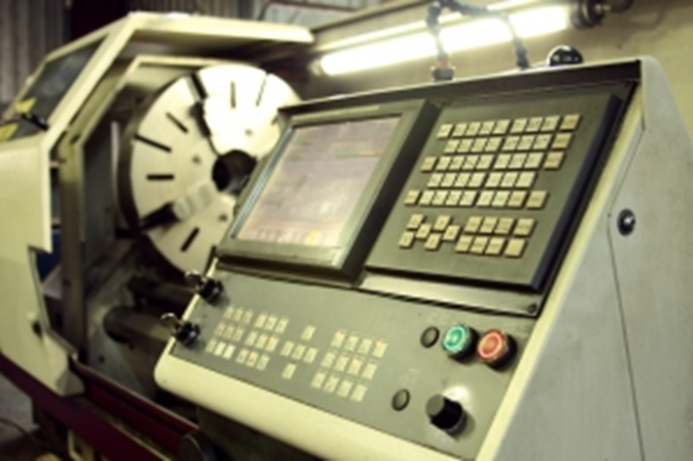
Manufacturing
A career in manufacturing is for you if you like to build things, take things apart, or design items.

Slide 4
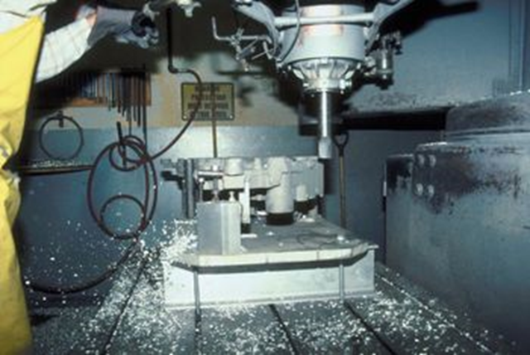
Manufacturing is . . .
Designing, transforming, and processing materials into a product to make life better.

Slide 5
What is a Career Pathway?
According to Hull (2004), a pathway is defined as “a coherent, articulated sequence of rigorous academic and career/technical courses, commencing in the ninth grade and leading to an associate degree, baccalaureate degree and beyond, an industry recognized certificate, and/or licensure.”

Slide 6
Manufacturing Pathways
Production
Manufacturing Production Process Development
Maintenance, Installation, and Repair
Quality Assurance
Logistics and Inventory Control
Health, Safety, and Environmental Assurance

Slide 7
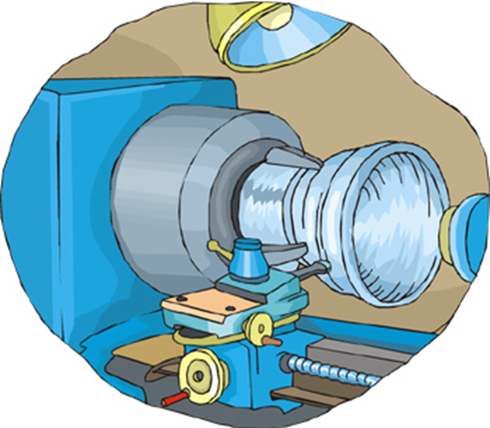
Production Pathway
In this pathway you will make the parts from raw materials and assemble the products.

Slide 8
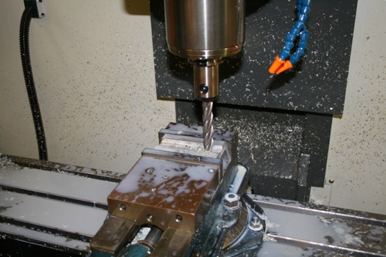
Career in Production Pathway
Mechanical Engineering Technologists
Team Assemblers
Computer Numerically Controlled Machine Tool Programmers

Slide 9
Process Development Pathway
In this pathway you will design and plan how to make a part or product.

Slide 10
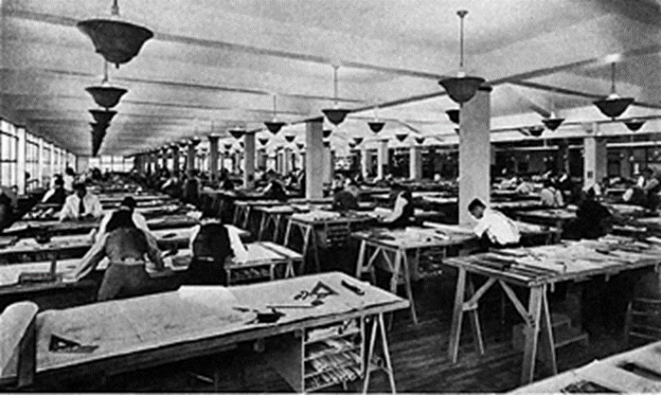
Careers in Manufacturing Process Development
Industrial Engineering Technicians
Industrial Engineers
Purchasing Agents

Slide 11
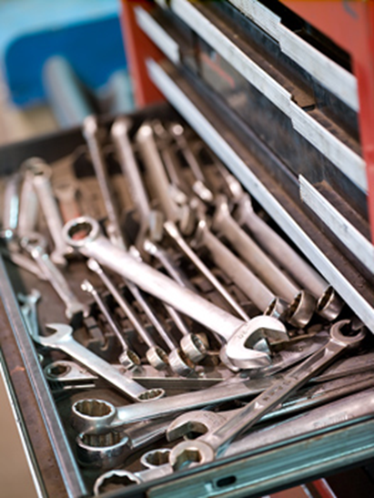
Maintenance, Installation, and Repair Pathway
This pathway worker repairs and maintains the equipment to make the parts.

Slide 12
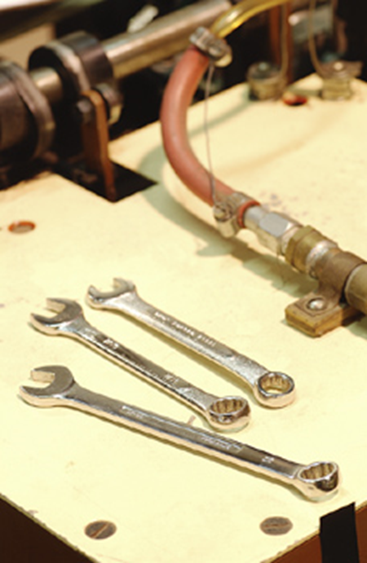
Careers in Maintenance, Installation, and Repair
Maintenance Repairer
Industrial Electronic Installers
Electrician
Biomedical Equipment Technician

Slide 13
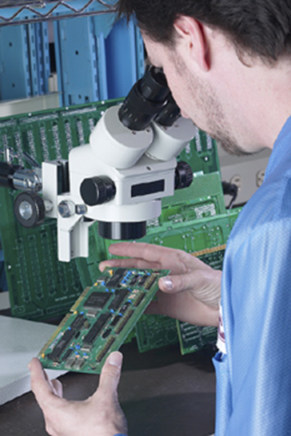
Quality Assurance Pathway
These are the people that inspect the parts and their performance.

Slide 14
Careers in Quality Assurance
Inspectors, Testers, Sorters, Samplers, and Weighers
Quality Control Analysts
Electronics Engineering Technicians

Slide 15
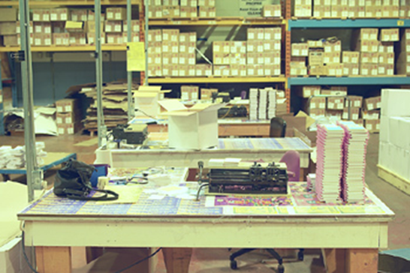
Logistics and Inventory Control Pathway
This pathway has people that order the materials needed to produce the parts and products made in the plant. They also check the material as it arrives at the plant and gets it to the machine when needed. They are responsible to ship the products out to the customers.

Slide 16
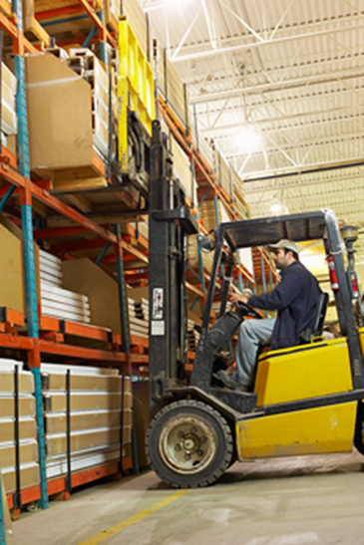
Careers in Logistics and Inventory Control
Logistics Engineers
Transportation Managers
Storage and Distribution Managers

Slide 17
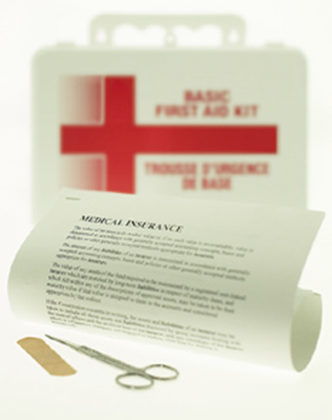
Health, Safety, and Environmental Assurance Pathways
Employees in this pathway oversee the safe working conditions in the plant. They also maintain the necessary materials for all governmental requirements.

Slide 18
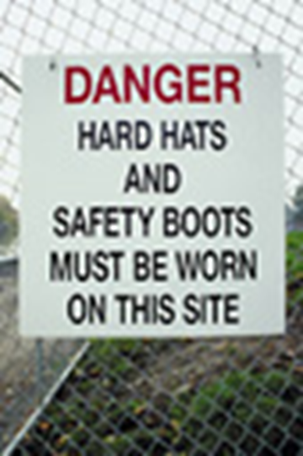
Careers in Health, Safety, and Environmental Assurance
Occupational Health and Safety Specialists
Industrial Safety and Health Engineers
Environmental Engineers

Slide 19
Resources
http://www.bls.gov/ooh/production/assemblers-and-fabricators.htm#tab-1
http://gov.texas.gov/files/ecodev/Manufacturing_in_Texas.pdf
http://manufacturetexas.org/
http://www.achievetexas.org/
http://www.onetonline.org/find/
http://www.clipart.com
http//www.texascaresonline.com/profile/occdata.asp?onetcode=43-5061.00

