Slide 1
Geometry in Architecture
Lesson 2

Slide 3
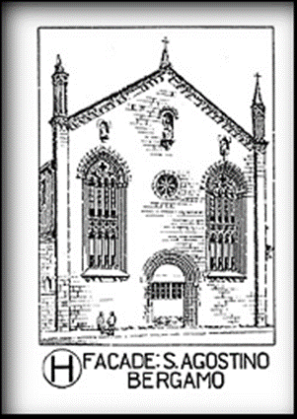
Façade Studies
I. Façade studies
a. Important element in overall architectural presentation

Slide 4
Façade Studies
b. Façade renovation of existing buildings represents big business
i. Has been done throughout history
Example: Sta. Maria Novella was an original Latin cross plan church designed by Fra Sisto and Fra Ristoro, 1278 to 1350, but is more recognized for the façade construction completed by Leon Battista Alverti in 1456

Slide 5
Façade Studies
ii. Private home and building owners often renovate the front of their house or building

Slide 6
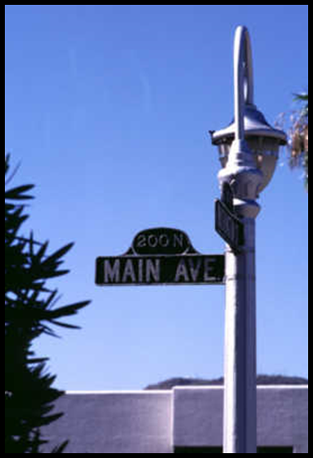
Façade Studies
iii. Recently renovations of the “Main Street” area of towns, shopping areas, mall, courthouse squares and other main parts of a town have become popular. In many cases, government improvement funds have financed the work

Slide 7
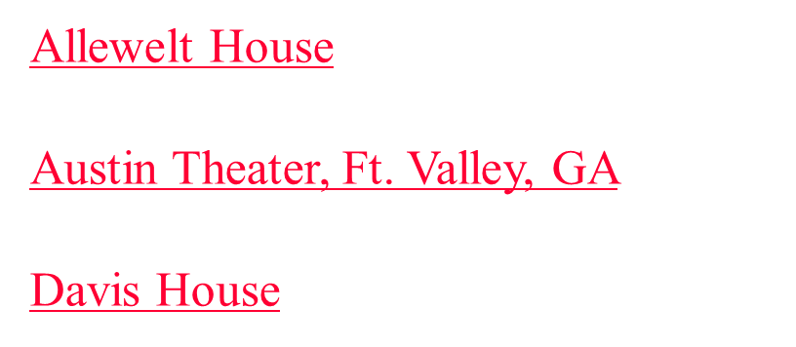
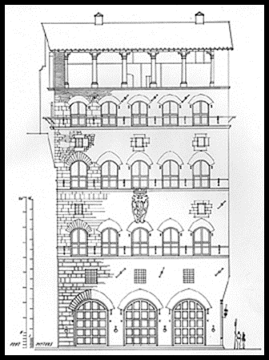
Façade Studies
c. Show examples of façade studies

Slide 8
Façade Studies
d. Lead the students in the “Random Building Activity”

Slide 9
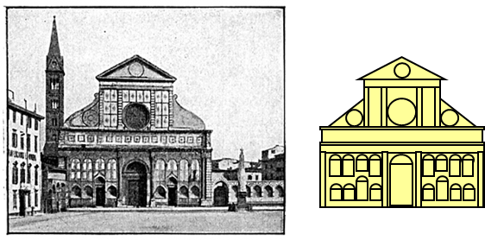
Evaluation of a Façade Study
II. Evaluation of a Façade Study
a. Elements
i. Geometric figures represent major parts of the structure:
Examples: rectangle = doors and windows; triangles = roof fronts

Slide 10
Evaluation of a Façade Study
ii. Proportion: vertical, horizontal
iii. Symmetry/Asymmetry
iv. Balance of Shapes
v. Pattern

Slide 11
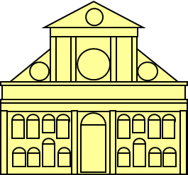
Evaluation of a Façade Study
b. Distribute handout “Façade Study Grade Sheet” and review
Students complete the “Sta. Maria Novella Puzzle” activity here

Slide 12
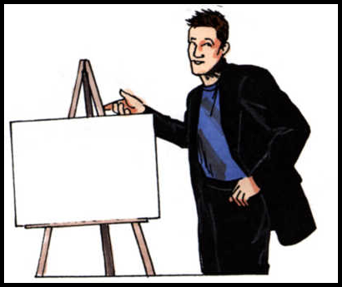
Evaluation of a Façade Study
c. Students present their façade construction
d. Students use copies of the “Façade Study Grade Sheet” to evaluate the facades presented

