Slide 1
The History of Manufacturing

Slide 3
Bell Work Activity
Answer the following questions on a sheet of paper.
List at least five consumer products that are still made by hand and not by an automated manufacturing process.
Refer to each product on the list and write down how many times you or a family member has purchased at least one of the products in the past three months.
Notes:
Use this exercise as an introduction to the history of manufacturing by discussing how modern day, mass production in manufacturing has its roots in the cottage industries, before the Industrial Revolution.

Slide 4
Warm-Up Activity: Terms and Definitions
There are several important terms and definitions students need to know.
Complete the History of Manufacturing Terms and Definitions handout.
Students may work in groups.
Notes:
Webster’s new compact office dictionary (2003). New York, NY: Houghton Mifflin
Harcourt Publishing Co.
Definitions make a great warm-up activity.

Slide 5
Home-based Manufacturing in Great Britain
Cottage Industry Manufacturing
In the 1700s, prior to the Industrial Revolution, most families lived in rural communities and made products at home or in small shops, on a small scale, to sell in local markets.
The income was usually only enough to take care of their living expenses.
Some merchants used these “home-based businesses” to custom manufacture their products.
This method was not cost-effective and was very inefficient.
The production capacity (amount of goods produced) was limited.
Notes:
Great Britain is considered the birth place of modern day manufacturing and the Industrial Revolution. This location had several advantages: a politically stable government, a strong workforce, and access to the necessary raw materials and resources.

Slide 6
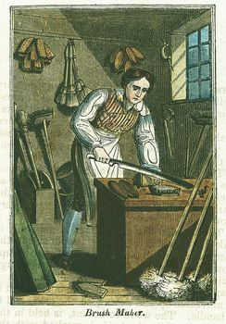
Home-based Manufacturing in Great Britain
Increased Demand for Goods
As populations grew in Great Britain and in the New World (America), consumers created markets with an ever increasing demand for goods.
Manufacturing processes were needed to create products more efficiently and in large quantities.
Notes:
Abraham Darby found a less expensive and easier way to produce cast iron. Henry Bessemer found an easier and cheaper way to mass produce steel. Iron and steel were critical in the manufacturing process.

Slide 7
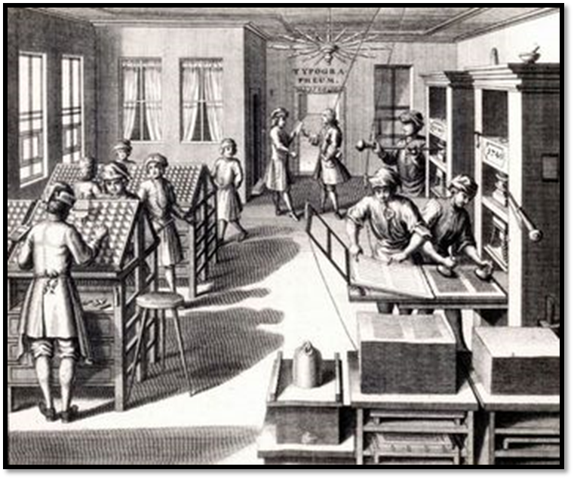
Mechanization and the Industrial Revolution
Men, Women, and Children in the Workforce
During the Industrial Revolution in the 1800s, a larger number of workers were needed in the factories.
Families moved from the rural communities to the cities to find work.
Notes:
The Industrial Revolution was underway in America in the 1800s. And by the early 1900s it was in full swing. Workers found themselves dealing with similar issues as workers in Great Britain had previously.

Slide 8
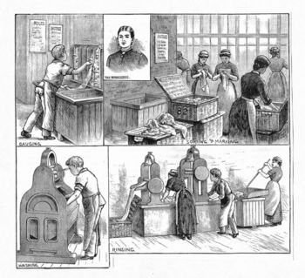
Mechanization and the Industrial Revolution
Entire families worked in manufacturing and in mining.
Working conditions were deplorable.
Injuries and deaths were commonplace.
Some merchants underpaid their employees and had no concerns for safety issues.
Notes:
The Industrial Revolution was underway in America in the 1800s. And by the early 1900s it was in full swing. Workers found themselves dealing with similar issues as workers in Great Britain had previously.

Slide 9
Mechanization and the Industrial Revolution
Trade Unions
Employees banded together and formed trade unions.
These groups would cause work stoppages by going on strike to force their employers to listen to their concerns about pay, safety, and working conditions.
Notes:
Trade unions become a major force in the fight for fair working conditions. Confrontations between management and labor sometimes became violent and sometimes required government intervention. Unions still exist today in many companies, and negotiations are now much more peaceful.

Slide 10
A Timeline of Technological Advances Impacting Manufacturing
Textile Production
In the late 1700s, in Great Britain, James Hargreaves created the “Spinning Jenny,” which allowed workers to produce multiple spools of thread at the same time. Other improvements in the weaving process dramatically improved the production of textile products.
In Great Britain, the textile industry produced fabric for clothing, blankets, and other uses. It had long been a staple of the cottage industry. Workers spun bulk cotton into thread by hand (one spool at a time) and wove the thread into cloth using manual weaving machines. As the Industrial Revolution grew, the demand for textile goods began to outpace the amount being produced by cottage industries.
Notes:
Edmond Cartwright invented the power loom used for the mechanization of the weaving process.

Slide 11
A Timeline of Technological Innovations Impacting Manufacturing
1790 >> >> >> 1836
1790 First U.S. patent issued for a cotton spinning machine
1794 Eli Whitney patents the cotton gin
1797 Eli Whitney contracts to make 10,000 guns for U.S. Army with interchangeable parts
1801 Steam-powered water pumping station installed in Philadelphia, Pennsylvania
1830 Joseph Henry invents electric motor
1831 Cyrus McCormick invents the grain cutting reaping machine
1883 Isaac Singer develops the sewing machine and safety pin
1836 Samuel Colt creates the six shooter revolver pistol
Notes:
Note:
Discuss the timeline events with the class.

Slide 12
A Timeline of Technological Innovations Impacting Manufacturing
1837 >> >> >> 1926
1837 Thomas Davenport uses electric motors to power shop tools and equipment
1843 Charles Goodyear “vulcanizes” rubber to make resistant to temperature changes
1857 Elisha Otis installs first passenger elevator in New York
1864 Samuel Van Sycel installs a five-mile oil pipe line, powered by an oil pump in Pennsylvania
1873 Christopher Sholes invents the typewriter
1902 Willis H. Carrier invents an air conditioning system
1903 Orville and Wilber Wright conduct the first powered airplane flight
1908 Henry Ford produced the Model T Ford automobile; starts using the assembly line process
1926 Robert H. Goddard, a physics professor, launched the first liquid-fueled rocket

Slide 13
A Timeline of Technological Innovations Impacting Manufacturing
1927 >> >> >> 1966
1927 Philo Farnsworth conducts the first television broadcast
1929 Clarence Birdseye provided commercially frozen food to the general public
1938 Reed and Prince Mfg. Co perfects the recesses head screws, saving time on assembly lines; Nylon cord invented by DuPont Co.
1939 John Atanasoff & Clifford Berry develop the first digital computer; it can add, subtract, and store data
1955 The first nuclear submarine was developed; it could stay submerged for four months
1963 NASA develops the first battery-powered hand tools for use during space walks
1964 IBM created OS/360, the first mass-produced computer operating system
1965 Digital Equipment Co. produces the first mini-computer (PDP-8) to use integrated circuit technology
1966 Xerox markets the first fax machine

Slide 14
A Timeline of Technological Innovations Impacting Manufacturing
1967 >> >> >> 1981
1967 The Amana Co. unveils the first microwave oven
1968 The programmable logic controller (PLC) developed to control automation on assembly lines
1969 NASA spacecraft put man on the moon; creates long-term growth in technology industries
1970 Corning Glass Co. develops fiber optic cables; allows faster, high quality transmission of images and sounds in the communication industry
1972 Noland Bushnell creates the first mass-produced video game (Pong); he eventually creates Atari game systems
1972 Texas Instrument Co. creates first pocket calculator; Phillips Co. markets first VCR for homes
1976 General Motors uses the first laser welder at a plant in Dayton, Ohio
1978 Volkswagen opens an automobile plant in New Stanton, Pennsylvania, the first foreign plant on U.S. soil
1981 NASA launches and recovers the first space shuttle

Slide 15
A Timeline of Technological Innovations Impacting Manufacturing
1981 >> >> >> 2007
1981 IBM markets the first personal computer (PC) to the general public
1985 The USDA approves the marketing of genetically-modified produce
1990 NASA uses the space shuttle to deploy the Hubble Telescope 350 miles in space, advancing our understanding of outer space
1990 “Lean Manufacturing” term is created from the book The Machine that Changed the World
1994 Boeing releases the first aircraft that was developed and preassembled entirely by computers, the Boeing 777
1994 The first internet web browser (Netscape Navigator) launched popularizing Internet searches
1999 General Motors Corp. open the first joint venture automotive plant in China
2001 China joins the Word Trade Organization (WTO); Apple release the iPod
2007 Manufacturing companies recognize the need to address environmental issues on the plant floor; initiates green manufacturing processes

