Slide 1
Skeletal Muscles

Slide 3
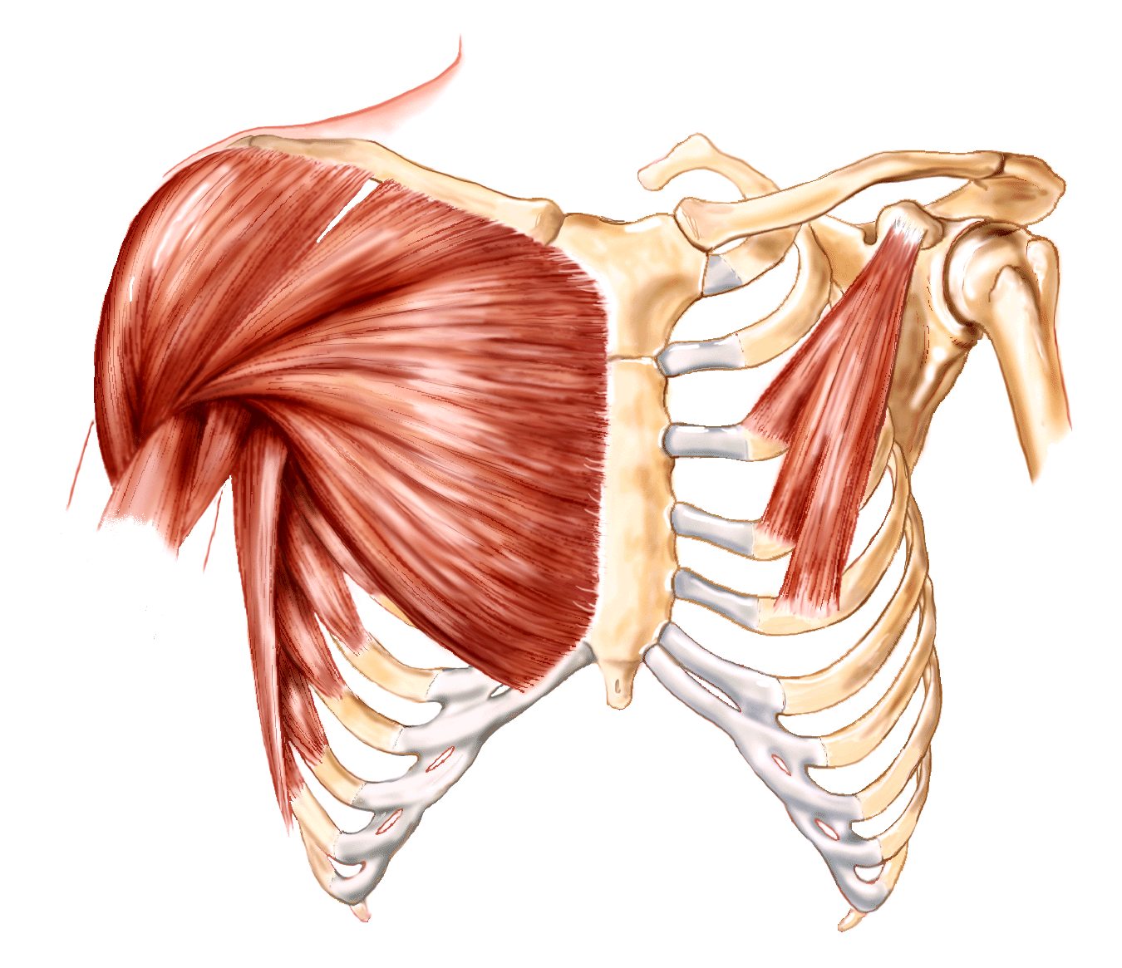
Muscles of the Anterior & Posterior Thorax
External intercostals
Internal intercostals
Diaphragm
Pectoralis minor
Pectoralis major
Trapezius
Rhomboids
Latissimus dorsi
Scalenes

Slide 4
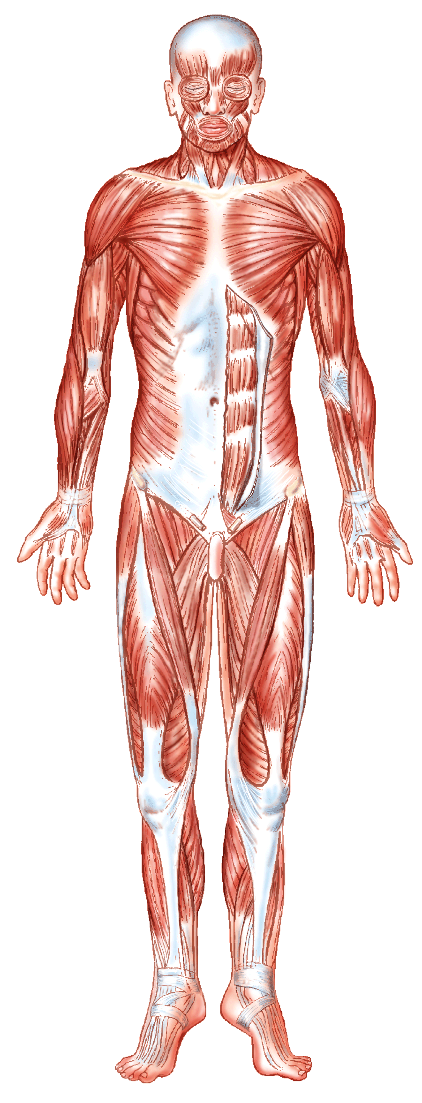
Muscles of the Abdominal Wall
Rectus abdominus
External oblique
Internal oblique
Transversus abdominus

Slide 5
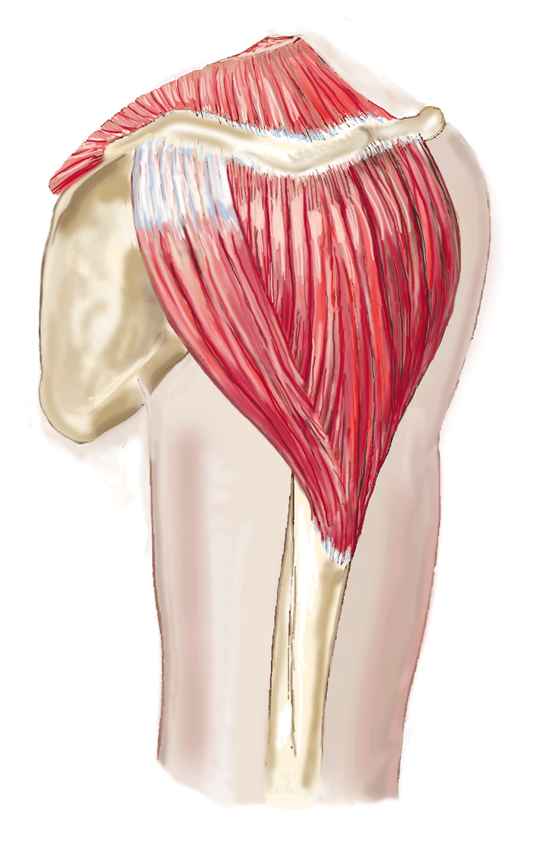
Muscles of the Shoulder Joint & Arm Movement
Pectoralis major
Latissimus dorsi
Deltoid
Rotator cuff: subscapularis, supraspinatus, infraspinatus, teres minor

Slide 6
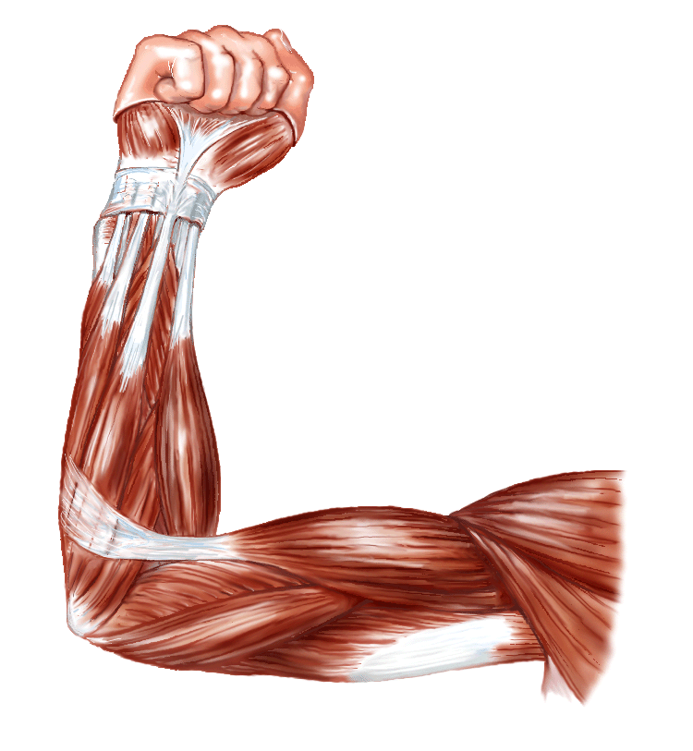
Muscles of the Elbow Joint
Triceps brachii
Biceps brachii
Brachialis
Brachioradialis

Slide 7
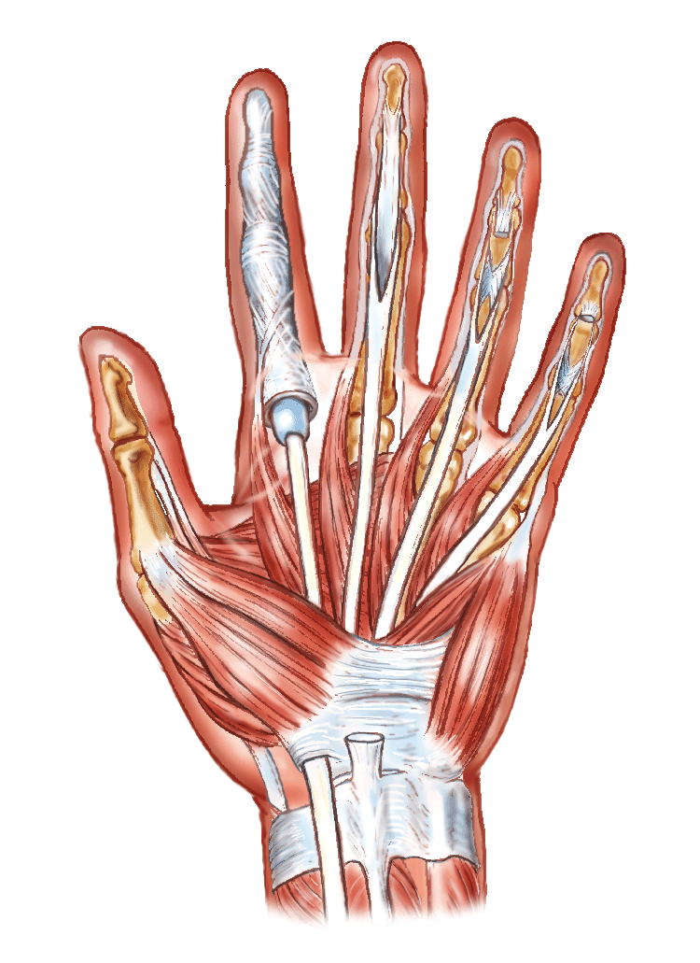
Muscles of the Wrist & Hand
Flexor carpi radialis
Flexor digitorum superficialis
Extensor carpi radialis longus
Extensor digitorum
Supinator

Slide 8
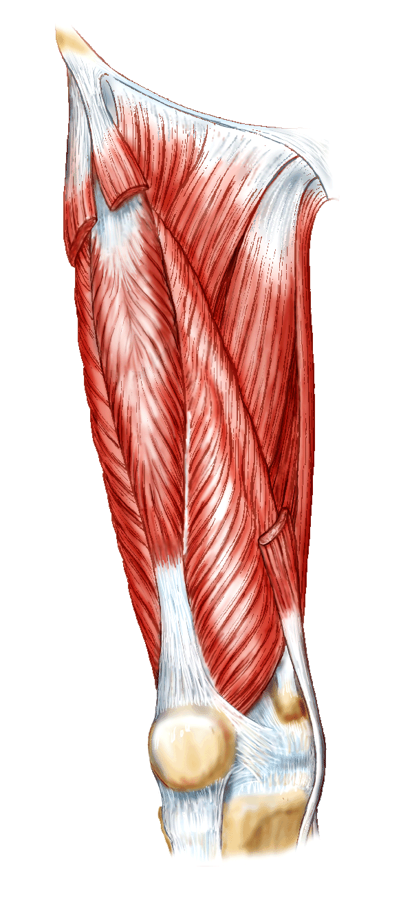
Muscles of the Hip and Knee Joint
Sartorius
Quadriceps femoris: rectus femoris, vastus lateralis, vastus medialis
Gracilis
Adductor longus
Hamstrings: biceps femoris, semitendinosus, semimembranosus
Gluteus maximus
Gluteus medius
Gluteus minimus

Slide 9
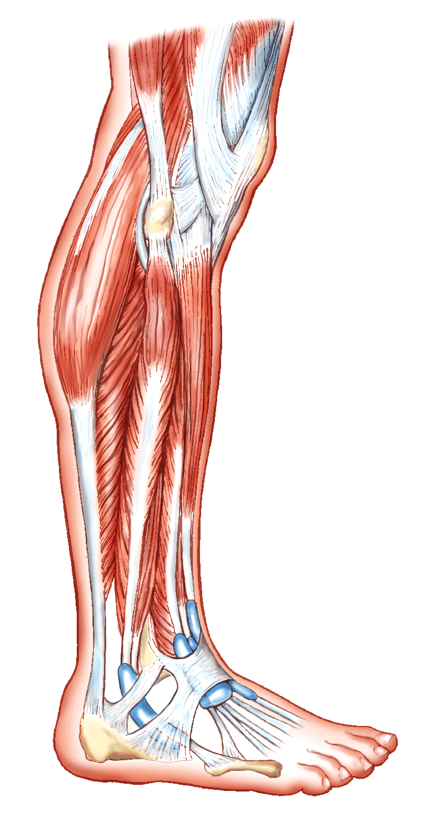
Muscles of the Lower Leg
Tibialis anterior
Gastrocnemius
Soleus
Peroneus longus
Extensor digitorum longus
Calcaneal tendon (Achilles)

Slide 10
