Slide 1
Vocabulary
For Audio Recording

Slide 3
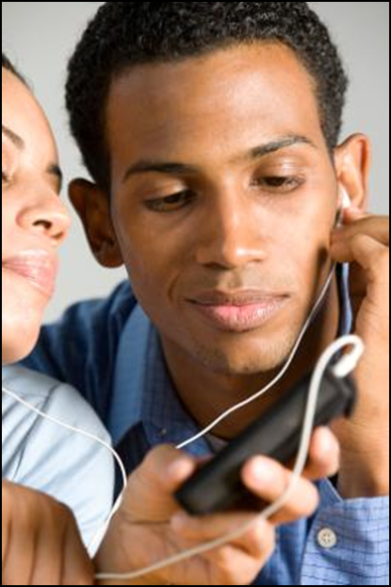
Audio
Sound, especially recorded and/or reproduced sound

Slide 4
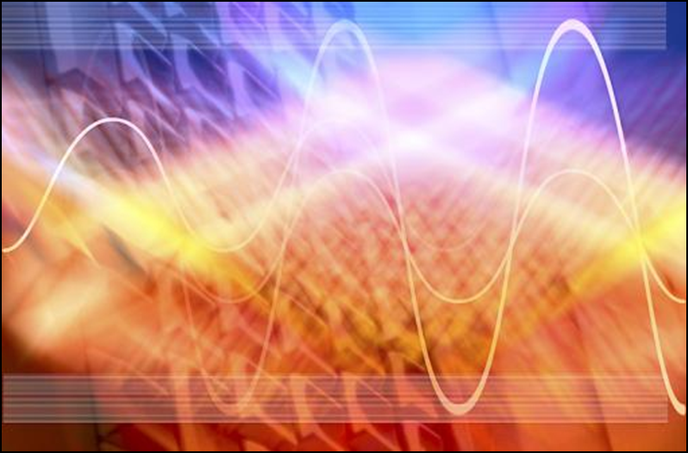
Frequency
The number of vibrations or waves per unit of time, usually given in cycles per second

Slide 5
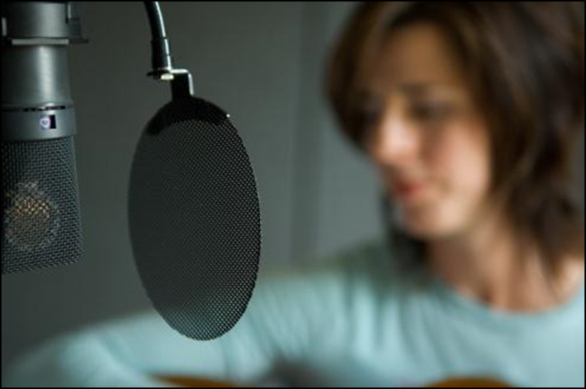
Microphone
An instrument that converts sound waves into an electric signal: used mostly for sound recording and/or reproduction

Slide 6
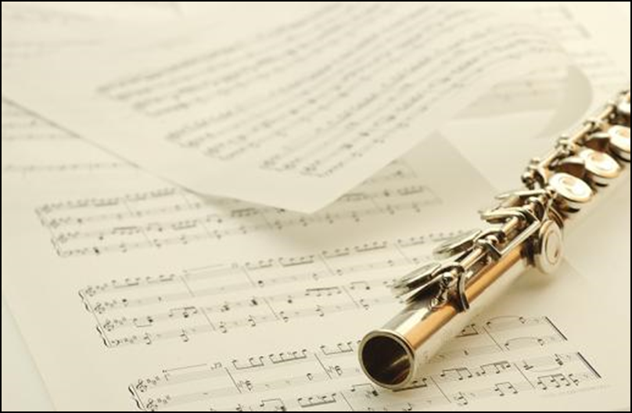
Pitch
The characteristic of sound determined by the frequency of the sound waves

Slide 7
PSA
Abbreviation for Public Service Announcement
A message prepared for media to deliver a message of public interest or benefit: usually from a non-profit, charitable, or government organization

Slide 8
Script
Written text of words to be spoken, particularly for stage, film, radio or television

Slide 9
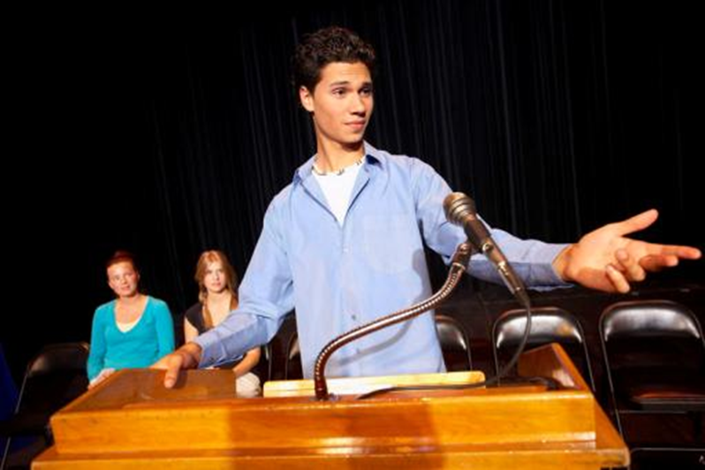
Sound bite
A sampling or short piece of speech taken from a longer speech or dialog

Slide 10
Sound card
An electronic piece of equipment added to a computer, usually as a plug-in card, that can record and play back sound

Slide 11
Sound clip
A short piece of sound taken from a longer feature; may also refer to a short sound recording inserted into a longer presentation such as a newscast

Slide 12
Sound wave
A wave of alternating high and low pressure areas moving through the air caused by the vibration of an object or vocal chord

Slide 13
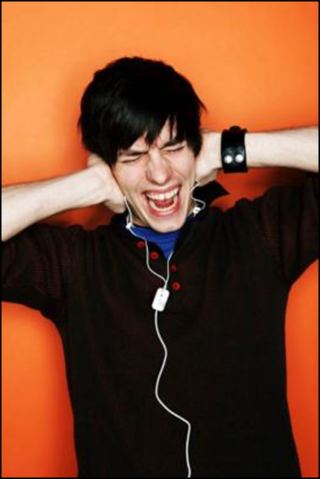
Volume
The loudness of sound

Slide 14
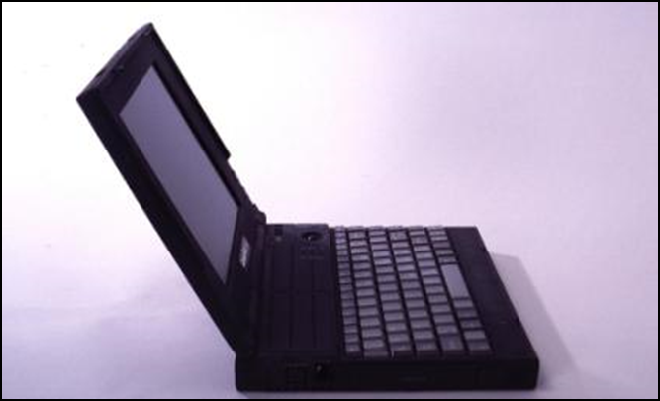
.wav
The format for storing sound in computer files

