Slide 1
Building Healthy Lifelong Relationships

Slide 3
Dating

Slide 4
Why Do People Date?
Notes:
Ask the students, “Why do people date?”

Slide 5
Why Date?
Socialization
Recreation
Mate Selection
Notes:
What is dating?
One definition is the activity of going out regularly with somebody as a social or romantic partner.
Why do we date?
Dating helps us discover ourselves and learn about others in a variety of settings. We do this for several reasons: for socialization, recreation and mate selection.

Slide 6
Socialization
How does dating provide social skills?
Notes:
Discuss the students' responses.

Slide 7
Purpose of Dating
Socialization
Developing appropriate social skills
Learn how to get along with others
Recognize the impact your words and actions have on others
Learn about yourself
Learn how to give and take in relationships
Notes:
Socialization is one of the reasons we date. Socialization means developing appropriate social skills. Other things that we gain from socialization are:
Learning how to get along with others
Recognizing the impact our words and actions have on others
Learning about ourselves
Learning how to give and take in relationships
Why are socialization skills important? Where do you learn socialization skills?

Slide 8
Recreation
How does dating provide recreational activities?
Notes:
Discuss the students' responses.

Slide 9
Purpose of Dating
Recreation
Have fun and enjoy the companionship of others
Try new and different activities
Notes:
Recreation is another reason we date. This allows us to have fun and enjoy the companionship of others. It also gives us a chance to try new and different activities.

Slide 10
Mate Selection
How does dating help you with selecting a mate?
Notes:
Discuss students' responses.

Slide 11
Purpose of Dating
Mate Selection
Helps you prepare for healthy relationships
Lets you see others in different settings
Helps you learn about others’ personalities and characteristics
Notes:
The last reason we date is mate selection. Dating helps us prepare for marriage by gaining communication skills and learning to give and take while in a relationship with others. Dating also allows us to see others in a different light that we might not otherwise get a chance to observe. It also helps us learn about others’ personalities and characteristics so we can discover what type of mate we are looking for. All of these things are important to explore when selecting a mate.
What type of personality and characteristics are you looking for in a mate? Why are these two components important?

Slide 12
Types of Dating
What are different types of dating situations?
Notes:
Now, let’s discuss types of dating.

Slide 13
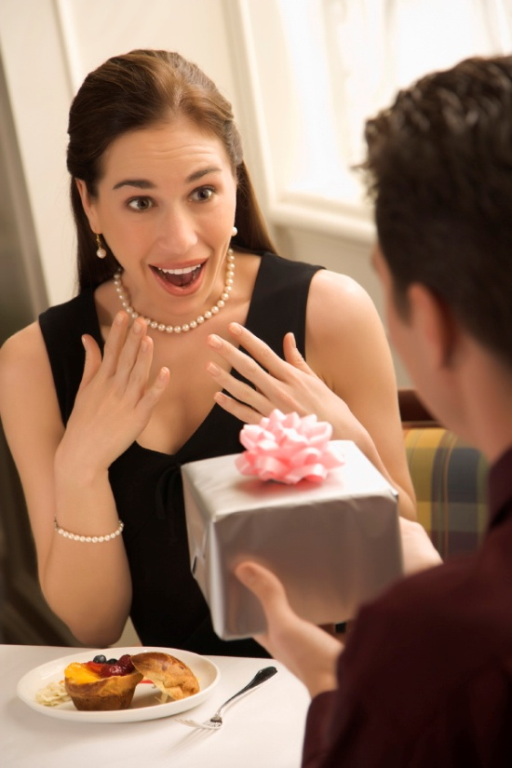
Types of Dating
Group Dating
Pair Dating
Steady Dating
Notes:
As you mature, you will most likely find yourself experiencing these different types of dating. They are group dating, pair dating and steady dating.

Slide 14
Group Dating
Also known as “hanging out”.
Activities are planned by both boys and girls such as:
going to the movies, the mall, or any other local hangout
Notes:
Group dating is also known as “hanging out.”
During this type of dating, activities are planned by both boys and girls such as seeing a movie, going to the mall or visiting any other local hangout.

Slide 15
Group Dating
Easy way to begin dating. You can begin talking to different people without the pressure
Gives you the opportunity to learn about many other types of people
Notes:
Group dating is an easy way to begin dating and talking to different people without the pressure of a one-on-one date.
Group dating also gives you the opportunity to learn about many other types of people.

Slide 16
Pair Dating
Also known as casual dating
No long-term commitment involved
Provides a chance to grow socially, and no one feels disloyal or jealous
May lead to a more serious relationship
Notes:
Next, there is pair dating, also known as casual dating. With this type of dating there is no long-term commitment involved.
People get a chance to grow socially, and no one feels disloyal or jealous.
Pair dating may lead to a more serious relationship.

Slide 17
Steady Dating
Also known as “going out”
Two people agree to date exclusively
Notes:
The last type of dating is steady dating, also known as “going out.” This occurs when two people agree to date exclusively.

Slide 18
Steady Dating
Provides security
You will have security that you will have a date when you need one.
You will know what to expect from the other person when you go somewhere.
Notes:
Steady dating provides security. People will have a date when they need one and will know what to expect from the other person when they go somewhere.

Slide 19
QUESTIONS?

Slide 20
Road to a Healthy Relationship

Slide 21
What are realistic expectations?
Notes:
What are realistic expectations pertaining to a healthy relationship?

Slide 22
Realistic Expectations
No one’s life is perfect and happy all the time.
Problems will arise, and what is important is how well you and your partner handle difficult situations together.
Notes:
Realistic Expectations
No one’s life is perfect and happy all the time.
Problems will arise, and what is important is how well you and your partner handle difficult situations together.
Why is it important for partners to have realistic expectations of each other in a relationship?

Slide 23
Realistic Expectations
Little Girl's Point of View of Marriage (click on link)
Notes:
Is being financially supportive a realistic expectation?
Is being financially supportive important in a relationship? Why or why not?
Are financial support and financial stability important in a marriage? Is it important to have a job before you get married? Why or why not?
5 Year Old Needs a Job before Getting Married
http://youtu.be/0rbMHLDY1pA

Slide 24
What is an Engagement?
Notes:
Engagement is the end of courtship and the beginning of plans to be married. It is a couple’s sign of intentions to marry.
An engagement serves three purposes:
to announce to the respected families and friends a couple’s intentions to marry
to test the relationship by evaluating compatibility
to give a couple time to plan the wedding, where they will live, finances and their future as husband and wife
The period of engagement allows a couple to seriously think about their future together. Communication is very important during the engagement period. What are some key issues that should be discussed at this time?
Things that should be discussed are:
Career goals
Family courtesies
Friendships
Future living arrangements
Issue of children
Money management
Personal habits
Personal priorities and goals
Religious preferences
Why are these important topics in a relationship?

Slide 25
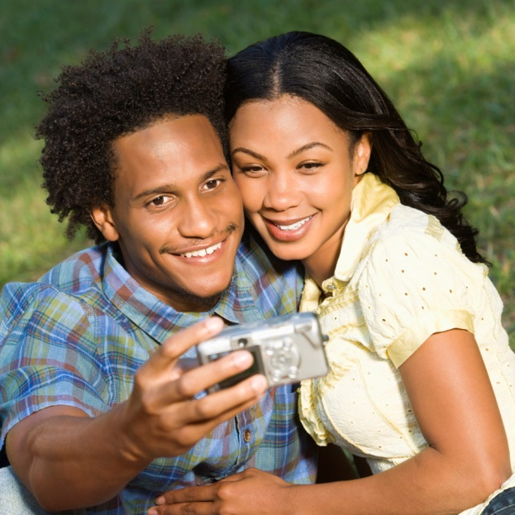
Sense of Humor
Laughing with - but not at - your partner is a healthy component to a relationship.
Notes:
Sense of Humor
A sense of humor is another component to a successful relationship. Laughing with--but not at--your partner is a healthy component to a relationship.
Do you think a sense of humor is an important component to a relationship?
What is the funniest thing that happened to you on a date?

Slide 26
Components of a Healthy Relationship
Notes:
What are the components of a healthy relationship?

Slide 27
Good Communication
What are the four ingredients to successful communication?
Notes:
What are the four ingredients to successful communication?

Slide 28
Good Communication
Four ingredients to successful communication?
Empathy
Keeping in touch
Sharing your ups and downs
Listening
Notes:
Good Communication
Four Ingredients to Successful Communication
What is empathy? Empathy allows you to understand how your significant other feels without sharing the same feelings at the moment.
Keeping in touch means talking about thoughts or feelings to keep up to date if your partner’s view has changed as well as recounting your day with each other.
Sharing your ups and downs is a way of sharing support and guidance.
Listening involves listening carefully and providing honest feedback to aid effective communication.
What are some other tips which help promote good communication between couples?

Slide 29
Problem Solving and Communication
Notes:
There is a saying that goes “We cannot help but communicate.” Even if our intent is to say nothing and to provide no feedback to other people, we are constantly communicating non-verbally through our facial expressions, eye contact and body language. When the verbal messages we send are not congruent with our body language, the listener may be unsure of the meaning of the spoken words. In other words, messages sent are often a messages not received because our words do not match our body language; we are sending a mixed messages.
Good listening is fundamental to a satisfying relationship. Some examples of principles and techniques of effective communication are the attitude of listening, avoiding interruption and criticism, discovering how things look from your partner’s point of view and listening sympathetically. Active listening involves paying close attention to what the other person is saying and is coupled with giving feedback.
Good communication fosters couple satisfaction and is an important component of family cohesion (emotional bonding of family members). Some characteristics of strong families include an appreciation for one another, positive communication, a high degree of commitment, a spiritual orientation and how family members can foster positive feelings for other family members.

Slide 30
Appreciation
Appreciation is shown through compliments, praise and thoughtfulness.
A simple “thank you” or a hug are ways to show appreciation.
Notes:
Appreciation is shown through compliments, praise and thoughtfulness. A simple “thank you” or a hug are ways to show appreciation. Presents are not necessary to show your partner that you appreciate him or her.
What are some other ways to show appreciation to your partner?

Slide 31
Trust
Trust is…..
Notes:
Ask the students what they think trust is.

Slide 32
Trust
Trust makes for a secure foundation.
To establish trust, one does not use or need power or force to hold the marriage together.
Notes:
Trust is an additional component to a successful relationship. Trust makes for a secure foundation. To establish trust, one does not use or need power or force to hold the relationship together. Trust grows with a relationship.
What happens if that trust is challenged, broken or destroyed?

Slide 33
Love
What Is Love? (click on link)
Notes:
What is Love?
Do marriage vows seem to mean as much today as they used to? If you've heard anything about the increase in divorce rates, you may wonder. Bill and Glad are ignoring the trends. More than ever the vows they made 50 years ago are being tested. In sickness and in health, in good times and in bad, the promise they are keeping is a true example of what love is.
http://youtu.be/GH5n9lVZcM4

Slide 34
Healthy Relationships Station Activities
Realistic Expectations
Good Communication
Sense of Humor
Trust
Appreciation
Notes:
Teacher note: Please discuss the station activities which will occur during Guided Practice and Independent Practice.
Five labeled file folders with each of the separate Healthy Relationships Station Activities will be set-up throughout the classroom. Each file folder contains specific instructions and activities. Students will rotate among all the stations and complete the required activities.

Slide 35
Five Station Activities
Groups will consist of 3-5 members.
Complete each activity.
All station activities will be turned in at the end of each day.
Notes:
You will be placed into groups of 3-5 members, depending on the size of your class. This will help to make sure that not too many students congregate at any one particular station while leaving the others empty.
There will be five stations set up around the room, and each station has its own activity. You are to move through the stations in your group as you complete the activity for each station. You will be turning in all of the individual station activities as you leave each day. The due date is two or three class periods from now.

Slide 36
Questions?

Slide 37
References and Resources
Images
Microsoft Clip Art: Used with permission from Microsoft.
Textbooks
Harter, Ph.D., M., & Ryder, V. (2004). Contemporary living. (9th ed.). Tinley Park, Illinois: The Goodheart-Willcox Company. Inc.
Johnson, L. (2010). Strengthening family & self. (6th ed.). Tinley Park, Illinois: The Goodheart-Willcox Company. Inc.
YouTube(tm):
5 Year Old Needs a Job Before Getting Married http://youtu.be/0rbMHLDY1pA
What is Love? Do marriage vows seem to mean as much today as they used to? If you've heard anything about the increase in divorce rates, you may wonder. Bill & Glad are ignoring the trends. More than ever the vows they made 50 years ago are being tested. In sickness and in health, in good times and in bad, the promise they are keeping is a true example of what love is. http://youtu.be/GH5n9lVZcM4

