Slide 1
Entrepreneurial Opportunities
Principles of Human Services

Slide 3
What is an Entrepreneur?
A person who organizes and operates a business or businesses, taking on greater than normal financial risks in order to do so
Notes:
Starting a small business can be exciting but hard work.
Is this an option you might be interested in?

Slide 4
Small Businesses
The U.S. Small Business Administration defines a small business concern as one that is independently owned and operated, is organized for profit and is not dominant in its field
An Introduction to the SBA
Notes:
Small businesses play an important role in today’s economy.
Click on link to view video:
An Introduction to the SBA
Every year the U.S. Small Business Administration and its nationwide network of resource partners help millions of small businesses start, grow and succeed. http://youtu.be/Wl_llIcT1V8

Slide 5
Human Services Career Cluster
Prepares individuals for employment in career pathways that relate to families and human needs
Notes:
There are five Programs of Study and nine Models for this Career Cluster.

Slide 6
Programs of Study
Consumer Services
Counseling and Mental Health
Early Childhood Development
Family and Community Services
Personal Care Services
Notes:
Programs of study is a way of organizing the curricula and educational activities within a career cluster related to a student’s specific academic and career goal.

Slide 7
Consumer Services
Notes:
Programs of Study Models include:
Financial Manager Advisor
Sales Representative Housing
Sales Manager Apparel

Slide 8
Program Profile
Professionals in this area help people with decisions and problems relating to:
Consumer goods
Finance
Insurance
Real estate
Notes:
Entrepreneurial opportunities may include:
Financial advice office
Insurance business
Loan business
Real estate business
Retail store
Can you think of any other businesses that fit in this category?

Slide 9
Counseling and Mental Health
Notes:
Program of Study Model includes:
Marriage & Family Therapist

Slide 10
Program Profile
Professionals in these occupations assist people with:
Career decisions
Educational options
Family matters
Mental health issues
Personal problems
Notes:
Entrepreneurial opportunities may include:
Counseling office
Health education business
Healthcare business
Mental health and substance abuse facility (county, local or state)
Rehabilitation business
Can you think of any other businesses that fit in this category?

Slide 11
Early Childhood Development
Notes:
Program of Study Model includes:
Child Care Director (Preschool & Kindergarten)

Slide 12
Program Profile
Professionals in these careers nurture and teach:
Preschool-age children
Notes:
Entrepreneurial opportunities may include:
Day care
Pre-school
Can you think of any other businesses that fit in this category?

Slide 13
Family and Community Services
Notes:
Program of Study Model includes:
Dietitians
Geriatric Care Manager
Social and Community Services Manager

Slide 14
Program Profile
Some professionals in this area help families and individuals meet their:
Nutritional needs
Others help vulnerable populations:
Care for the elderly
Cope with problems of daily living
Counsel troubled individuals
Solicit contributions for various social agencies
Train or retrain the unemployed
Notes:
Entrepreneurial opportunities may include:
Home health agencies
State, county or local agencies
Can you think of any other businesses that fit in this category?

Slide 15
Personal Care Services
Notes:
Program of Study Model includes:
Cosmetologist

Slide 16
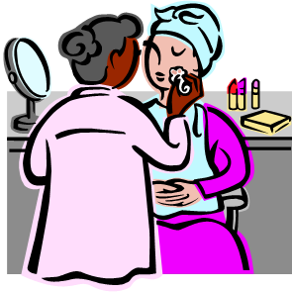
Program Profile
Personal care professionals help people with their:
Personal appearance, including:
Giving makeup advice
Giving manicures
Providing facial treatments
Styling hair
They may also provide:
Fitness training
Health
Notes:
Entrepreneurial opportunities may include:
Barber shop
Beauty salon
Fitness gym
Spa
Can you think of any other businesses that fit in this category?

Slide 17
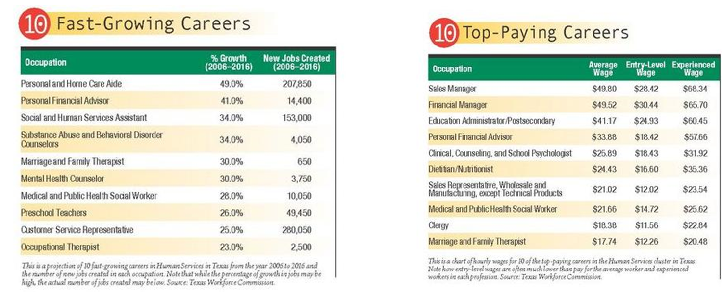
Careers
Notes:
According to the AchieveTexas: Human Services College and Career Planning Guide, the Texas Workforce Commission projects endless growth opportunities in these areas.
Let’s begin to think of our own business!

Slide 18
Questions?

Slide 19
References and Resources
Images:
Achieve Texas In Action: Human Services
Microsoft Office Clip Art: Used with permission from Microsoft.
Textbook:
Littrell, J. J., Clasen, A. H., & Pearson, P. (2004). From school to work. Tinley Park, IL: Goodheart-Willcox.
Websites:
Achieve Texas College and Career Initiative
An education initiative designed to prepare students for a lifetime of success. It allows students to achieve excellence by preparing them for secondary and postsecondary opportunities, career preparation and advancement, meaningful work, and active citizenship.
http://www.achievetexas.org/
O*Net Online
Human Services Career Cluster
http://www.onetonline.org/find/career?c=10&g=Go
SBA.gov
The U.S. Small Business Administration (SBA) was created in 1953 as an independent agency of the federal government to aid, counsel, assist and protect the interests of small business concerns, to preserve free competitive enterprise and to maintain and strengthen the overall economy of our nation.
http://www.sba.gov/
YouTube™:
An Introduction to the SBA
Every year the U.S. Small Business Administration and its nationwide network of resource partners help millions of small businesses start, grow and succeed. http://youtu.be/Wl_llIcT1V8

