Slide 1
Investigating Food Science Professions
Ensuring a nutritious, safe and abundant food supply

Slide 3
Careers
Production
Quality Control
Manufacturing
Foodservice
Distribution
Dietetics
Notes:
People working in food science careers grow, process, manufacture and distribute all the foods we eat.
Ingredients, additives, packaging and processing equipment for all food products are also created or done by people working in this industry.

Slide 4
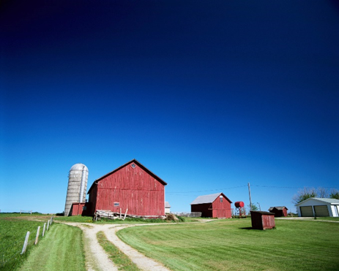
Food Production
Jobs
Farms that grow:
Fruits
Grains
Livestock
Nuts
Poultry
Vegetables
New types of farms:
Aquaculture
Organic
Careers
Biologists
Biotechnologists
Botanists
Farmers
Notes:
Aquaculture farms raise fish and shellfish.
Organic farms must not use conventional pesticides, insecticides or pesticides in their crops and must meet the requirements of the National Organic Foods Production Act of 1990 to be certified.
Biologists and botanists study ways to improve the quality and quantity of basic foods.
Biotechnologists research and develop new crops.
Farmers operate the farms that grow crops, orchards and more.

Slide 5
Food Manufacturing
Jobs
Raw foods are processed for:
Washing
Canning
Freezing
Drying
Packaging
Also refines, combines and alters foods to make other products
Careers
Food engineers
Food marketing experts
Food packaging specialists
Microbiologist
Notes:
Most foods go through changes in the manufacturing stage.
Food engineers, microbiologists, packaging specialists and marketing experts all work together to develop new food products.

Slide 6
Food Distribution
Jobs
Involves hauling and storing food
Careers
Food distributors
Food engineers
Notes:
Distributors move foods from the farm to the processing plant to the warehouse and distribution centers and then to markets.
Engineers work with food scientists to design packaging that will protect food from damage during shipping.

Slide 7
Quality Control
Jobs
Ensure that food products:
Are safe and meet federal regulations
Meet a set standard of quality
Careers
Food inspectors
Food testers
Notes:
Some workers in this field may work for the federal, state and county agencies.
Other workers may be employed by food manufacturers.

Slide 8
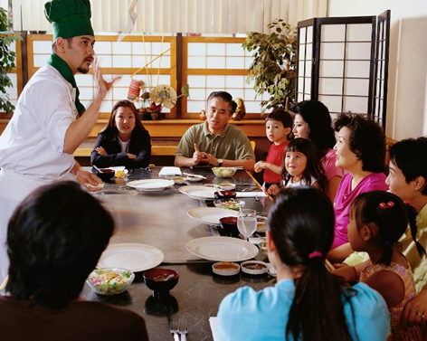
Foodservice
Jobs
Involves preparing meals and serving them
Careers
Entry-level:
Bus Persons
Cooks
Hosts
Servers
Skilled:
Chefs
Notes:
Workers in the foodservice industry turn raw and manufactured food products into a food item or meal that is ready to eat.
Most chefs complete a two- to four-year program in culinary arts to prepare meals that are flavorful to customers.
Many culinary arts programs involve training in food science.

Slide 9
Dietetics
Jobs
Applies nutritional principles to meal planning and preparation
Careers
Dietitian
Notes:
Dietitians are professionals who assess diets and plan nutritional programs.
A registered dietitian has passed a national exam given by the Academy of Nutrition and Dietetics.

Slide 10
Employment
Business
Education
Government
Notes:
Most food scientists work for one of these three divisions of employment.

Slide 11
Business
Goal
To produce goods and services for profit
Division
Companies that make food-related products
Trade organizations that promote various foods
Notes:
Many food scientists work for private businesses that promote one or more foods.

Slide 12
Education
Goal
To teach students
Division
Employs people who teach food science in public and private schools
Notes:
Food scientists who want to do research and teach work at colleges and universities.
Family and consumer science instructors may teach this course at the high school level.

Slide 13
Government
Goal
To protect the well-being of citizens
Division
Federal
Commerce Department
Food and Drug Administration (FDA)
U.S. Department of Agriculture (USDA)
State or local
Departments of health
Notes:
Most food scientists working in the federal, state or local divisions are researchers or inspectors.

Slide 14
What is Food Science and Technology?
Notes:
Click on hyperlink to view video:
What Is Food Science and Technology?
Learn what food science is all about and hear from people that work in the profession about what it’s like to work in food science.
http://www.ift.org/knowledge-center/learn-about-food-science/what-is-food-science.aspx

Slide 15
Questions?

Slide 16
References and Resources
Images:
Microsoft Office Clip Art: Used with permission from Microsoft.
Textbook(s):
Mehas, K. Y., & Rodgers, S. L. (2002). Food science: The biochemistry of food and nutrition. New York, NY: Glenco/McGraw-Hill.
Ward, J. D., & Ward, L. T. (2013). Principles of food science. Tinley Park, IL: Goodheart-Wilcox Company.
Website:
Institute of Food Technologists
Feeding the minds that feed the world
http://www.ift.org/

Slide 17
References and Resources
Video:
What Is Food Science & Technology?
Learn what food science is all about and hear from people that work in the profession about what it’s like to work in food science.
http://www.ift.org/knowledge-center/learn-about-food-science/what-is-food-science.aspx

