Slide 1
Payment Options and Exchange Rates

Slide 3
Payment Options
Notes:
Payment - an amount of money that is paid for something.
We have many payment options to choose from.

Slide 4
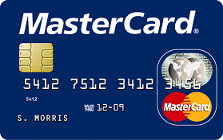
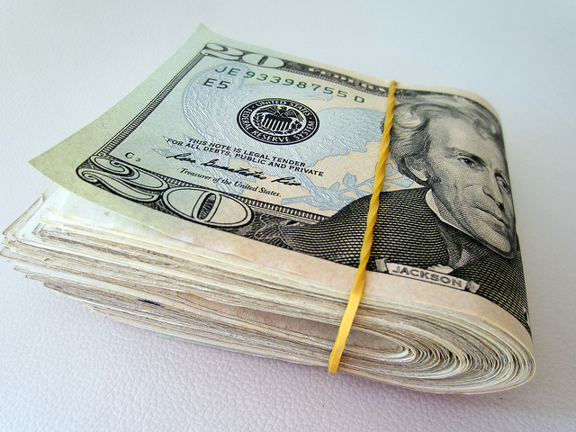
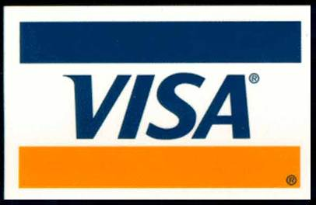
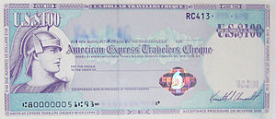
Payments
Cash
Check
Credit card
Debit card
Electronic check
Money order
Traveler’s check
Notes:
Paying for travel today is the same as purchasing any item.
Travel can be paid for by:
Cash
Check
Credit card
Debit card
Electronic check
Money order
Traveler’s check
Can anyone tell me the difference between a check, such as a personal check, and an electronic check?
A personal check that is taken must be taken to a bank and is deposited in the account of the person or company accepting the check as payment. Then that bank will send the check to the bank of the person writing the check who will send the funds electronically, the accepting bank receives the funds. This transaction may take several days.
An electronic check still uses a personal check but the transaction is all handled at the point-of-sale and the register/computer will electronically retrieve the funds from the check writer’s account instantly. Many retail businesses now handle personal checks in this manner.
A traveler’s check is preprinted for a fixed-amount (e.g. $50 or $100) and typically sold through banks. They are designed to allow the person purchasing and signing it to make a payment to someone else. Use of these has declined over the last 20 years as credit cards, debit cards and automated teller machines have become wide spread.

Slide 5
Internet for Travel and Tourism
Hospitality
Customers can:
Book hotel rooms online
Buy tickets for events
Make airline reservations
Plan vacations
Rent cars
View hotel website for location and room rates
Restaurants
Customers can:
Make reservations
Order take out food
View restaurant website for hours of operation, location and menus
Notes:
The Internet has had a large impact on how people travel, where they choose to stay overnight and where they eat.
Customers/guests can visit company websites to make these decisions.

Slide 6
Property Management Systems (PMS)
Notes:
The PMS computer software and hardware are used to run lodging properties.
It keeps all the information for all departments in one computer system.
Guest check-in information used to be recorded by hand and kept in log books before this system.

Slide 7
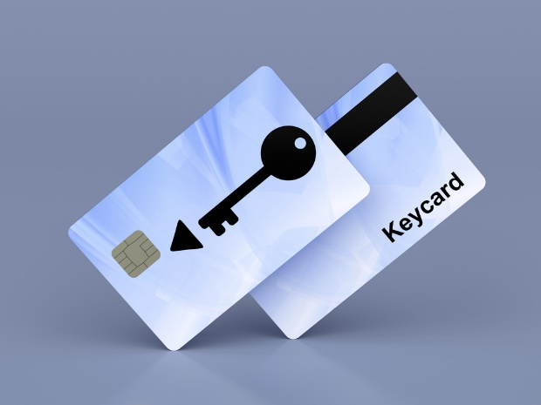
PMS Systems
Creates a guest folio
Keeps track of guest purchases
Generates a bill
Produces electronic key cards
Can handle:
Accounting
Inventory
Purchasing
Receiving
Notes:
Guest folio – a record of all transactions of both cash and credit incurred by a hotel guest.
Electronic key systems – a card with a magnetic strip that contains the room combination

Slide 8
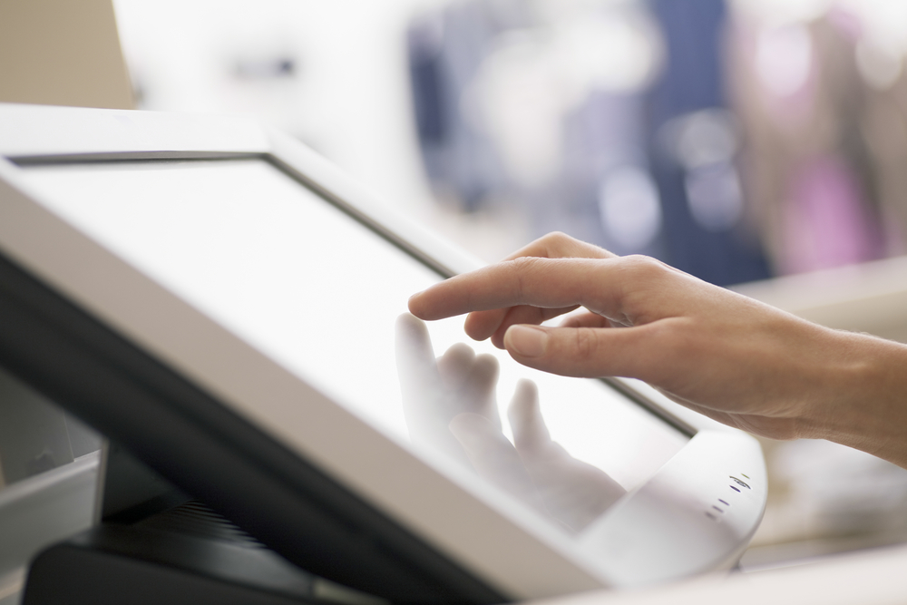
Point of Sales System (POS)
Notes:
The POS system is a computerized system for recording an order at the place where the order is taken
It has improved the accuracy of the menu orders.

Slide 9
POS Systems
Calculates charges and taxes
Keeps track of menu items sold
Processes credit cards
Records payments
Sends orders to kitchen
Tracks inventory
Can handle:
Accounting
Employee
Scheduling
Time clock
Payroll
Sales reports
Notes:
The POS system has increased employee efficiency and overall company productivity.

Slide 10
Exchange Rates
Notes:
Exchange rate - number that is used to calculate the difference in value between money from one country and money from another country.

Slide 11
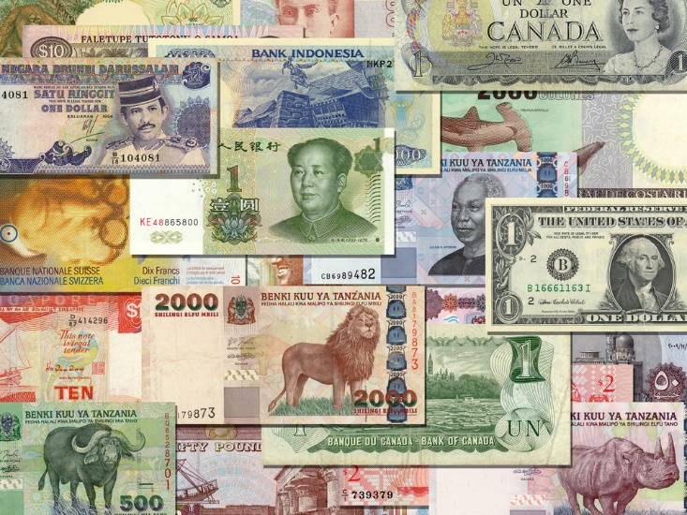
Payments in Foreign Countries
U.S. cash
Foreign currency
Debit or credit cards
Traveler’s check
Notes:
How do you pay for things when you travel to a different county?
There are actually 4 options.
1. U.S. cash – The U.S. dollar is well respected and most countries will take U.S. currency. When others travel to the U.S., most places other than banks and the Exchange Bureau will NOT take foreign currency.
Foreign currency – This can be confusing at first because of the varying exchange rate and the exchange rate offered is different depending on when and where you convert your money. There are six options for converting money.
convert before you leave – either from banks or travel agencies
convert with a country‘s bank – most foreign banks will exchange U.S. dollars
convert with a country’s ATM – use your debit or credit card on a ATM machine when you arrive – usually the best exchange rate but will have a fee – best to know the exchange rate so you don’t exchange too much money
convert at your hotel – large hotels catering to foreign travels often will exchange U.S. dollars if they have enough currency but the exchange rate might not be very favorable
convert with the Currency Exchange Bureau – either in the U.S. airport prior to leaving or when you arrive – currency exchange bureaus are more common in other countries
convert on the street – this is the worst idea – the exchange rate will most likely be the poorest and you could be converting to counterfeit currency
Debit or credit cards – this is becoming the preferred method of payment for travelers as the exchange rate is usually favorable but the card issuer may charge a fee for conversion
Traveler’s check – can be used and can be issued in either U.S. dollars or in foreign currency

Slide 12
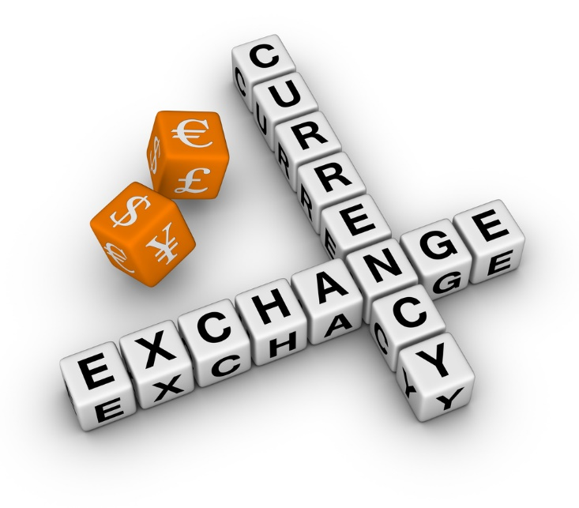
Currency
Travelers to foreign countries should be mindful of:
Exchange rates change daily
Fees may be charged to convert
Some currencies have the same name
Notes:
Exchange rates
A traveler to foreign countries need to be mindful of a few things:
Exchange rates will change daily and can change by a large percent. For example, a meal might cost the equivalent of $35 U.S. dollars one day and can change to $45 the next day. It can also go in the other direction as well. So it might be wise to watch how much money is converted at one time.
Fees are charged to convert. At the end of your travels, if you have left over money you can convert it back to U.S. dollars, but keep in mind you will be paying fees to convert in both directions.
Currency names can have the same name. For example, the U.S., Canada, Singapore, New Zealand, and Australia all call their currency “dollars” but will have a different value than the U.S. dollar. This can be confusing when communicating in the price and purchasing of items.

Slide 13
Rates of Exchange
To convert U. S. dollars to foreign currency:
Number of U.S. dollars X current foreign units
Examples:
$48.00 X .90€ = 43.20€
(U.S. dollars x euro)
$299.00 X $15.71 = $4697.30
(U.S. dollars x Mexican peso)
To convert foreign currency to U.S. dollars:
Foreign currency units ÷ foreign currency units per U.S. dollar
Examples:
43.20€ ÷ .90€ = $48.00
-(euro ÷ current exchange rate to the U.S. dollar)
4697.30 ÷ $15.71 = $299.00
-(Mexican peso ÷ current exchange rate to the U.S. dollar)
Notes:
Exchange rates may change daily.
Be sure to check the current exchange rate before calculating.

Slide 14
Currency Tips for Traveling in Europe
Notes:
Click on hyperlink to view video:
Currency Tips for Traveling in Europe
Learn these currency trips for traveling in Europe so that you never have the wrong currency while traveling in Europe. Here are important currency tips for traveling in Europe, including what countries use the Euro and where to exchange money.
http://video.about.com/goeurope/Currency-Tips-For-Traveling-in-Europe.htm

Slide 15
Notes:
What does this quote mean to you?

Slide 16
Let’s Review!
What types of payment options are available to travelers?
What has the Internet done for travel and tourism?
What is the difference between a PMS and POS system?
What is an exchange rate?
What type of payments can you use in foreign countries?
What should travelers in foreign countries be mindful of?
How do you exchange U.S. dollars to foreign currency?
How do you exchange foreign currency to U.S. dollars?
Notes:
Answers to the questions are found within the slide presentation or may vary with class discussion.

Slide 17
References and Resources
Images:
Microsoft Office Clip Art: Used with permission from Microsoft™. (Slides 3)
Shutterstock™ images. Photos obtained with subscription. . (Slides 3, 6, 7, 8, 9, 11, 12, 15, 17)
Textbook:
Mancini, M. (2013). Access: Introduction to travel and tourism. Clifton Park, NY. Cengage Learning.
Reynolds, J. S. & Chase, D. M. (2010). Hospitality services. Tinley-Park, Illinois: The Goodheart-Willcox Company.
Website:
Business Insider
MAP: The Most Popular Countries In The World To Visit
http://www.businessinsider.com/most-popular-countries-in-the-world-to-visit-map-2014-2
U. S. Department of the Treasury, Bureau of the Fiscal Service
Treasury Reporting Rates of Exchange
https://www.fiscal.treasury.gov/fsreports/rpt/treasRptRateExch/currentRates.htm
Video:
Currency Tips For Traveling in Europe
Learn these currency trips for traveling in Europe so that you never have the wrong currency while traveling in Europe. Here are important currency tips for traveling in Europe, including what countries use the Euro and where to exchange money.
http://video.about.com/goeurope/Currency-Tips-For-Traveling-in-Europe.htm

