Slide 1
Principles of Infection Control
Introduction to Cosmetology

Slide 3
Bacteria
Notes:
There are thousands of different kinds of bacteria.

Slide 4
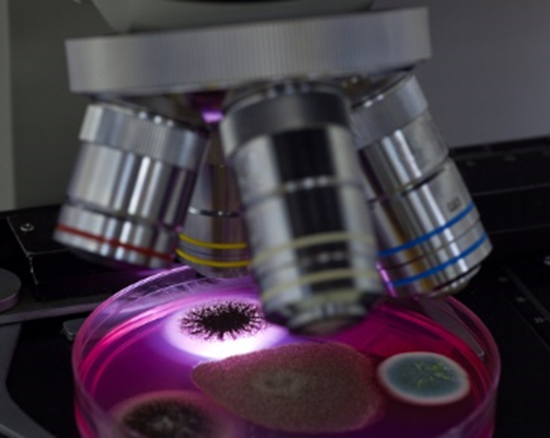
What is bacteria?
A one-celled microorganism having both plant and animal characteristics
Notes:
Some bacteria are harmful and some are harmless.
They are so small they can only be seen with a microscope.

Slide 5
Where is Bacteria found?
Bacteria can be found in:
Air
Body secretions
Clothing
Decayed matter
Environmental surfaces
Free edge of nails
Skin
Water
Notes:
Bacteria can be found almost anywhere.
Can you think of where they may be found in a salon?

Slide 6
Parasites
Notes:
Parasites can be found in food, on plants and trees and in water.

Slide 7
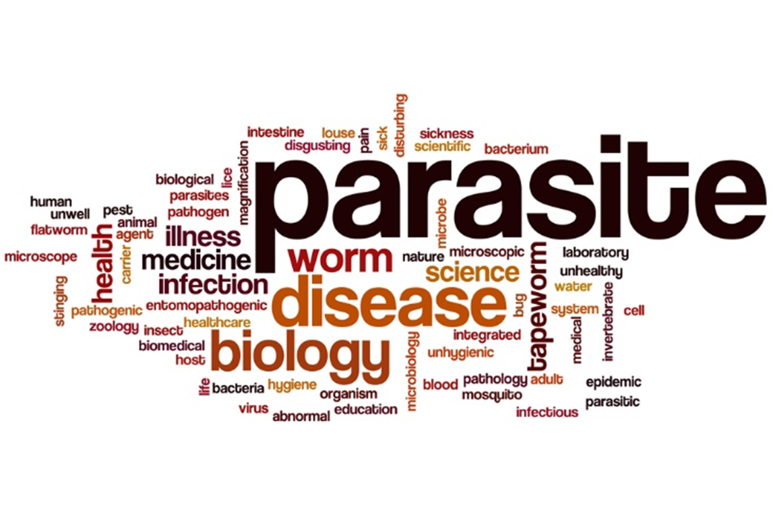
What is a parasite?
Organisms that grow, feed and shelter on or in another organism while contributing nothing to the survival of that organism
Notes:
They must have a host to survive.
They can live on or inside of humans or animals.

Slide 8
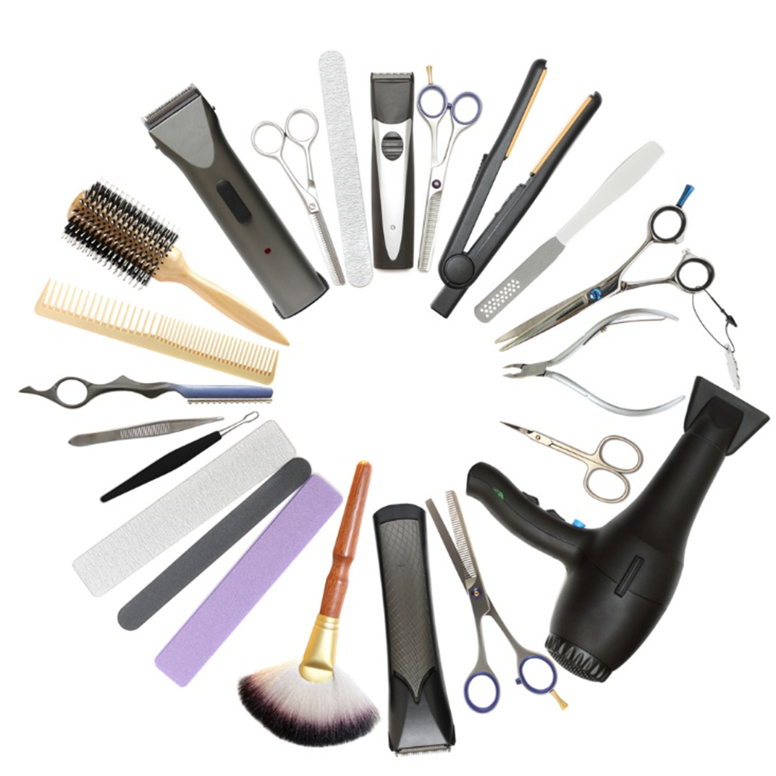
Other Parasites
Fleas
Head lice
Mites
Scabies
Ticks
Notes:
These contagious diseases may spread other clients by using contaminated utensils that have not been cleaned and disinfected.
These diseases should only be treated by a doctor.

Slide 9
Viruses

Slide 10
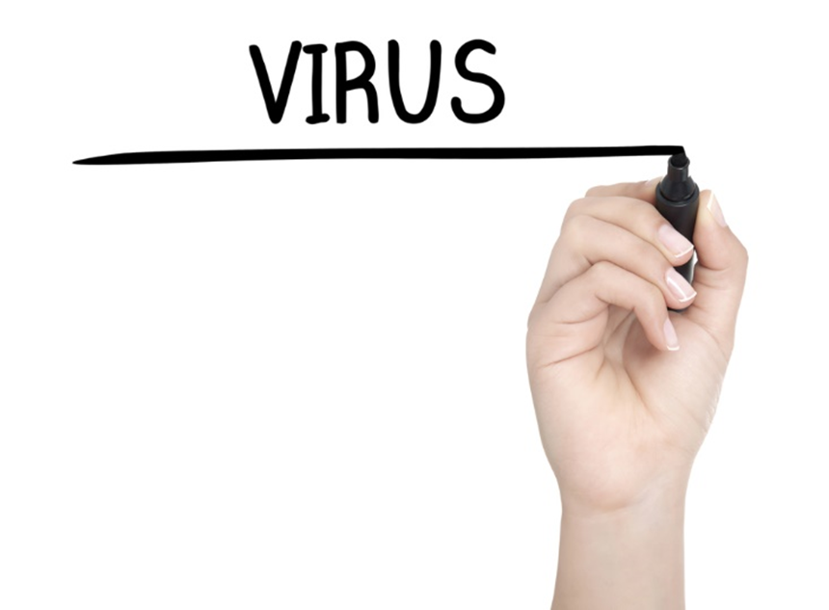
What is a Virus?
A parasitic submicroscopic particle that infects and resides in cells of biological organisms
Notes:
A virus can live and reproduce only by taking over other cells and becoming part of them.

Slide 11
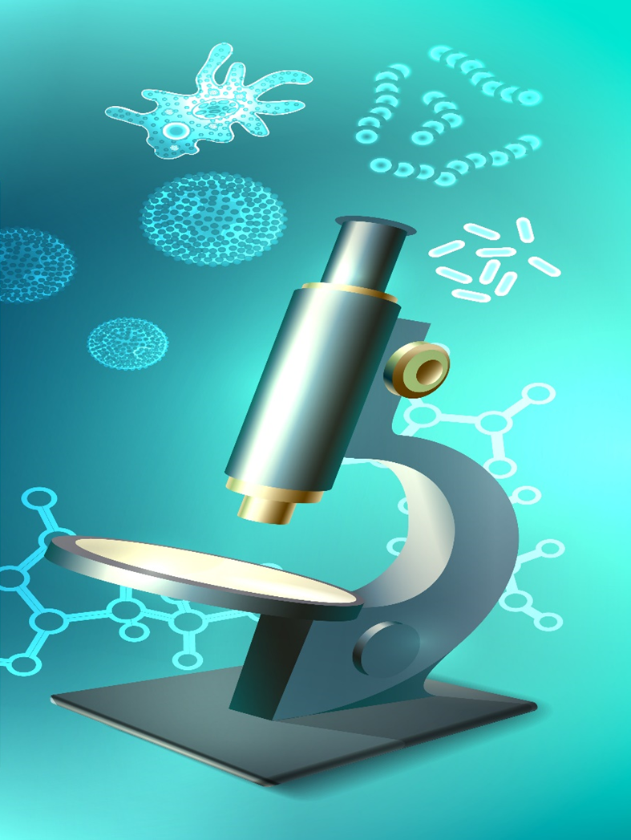
Viruses can cause
Common colds
Gastrointestinal infections
Respiratory infections
Notes:
Viruses are so small that they can only be seen under the most sophisticated and powerful microscopes.

Slide 12
Other viruses
Chicken pox
Hepatitis
HIV
AIDS
Influenza
Measles
Mumps
Polio
Rabies
Smallpox
Yellow fever
Notes:
Bacteria can live and reproduce on their own.
Bacterial infections can usually be treated with antibiotics.
Viruses are not affected by antibiotics.

Slide 13
Nail salon inspections
Unsanitary Conditions at Nail Salons Pose Health Risk
Inspection Records Reveal Big Fines at Some DFW Nail Salons
Notes:
Click on hyperlinks to view videos:
Unsanitary Conditions at Nail Salons Pose Health Risk
The unsanitary conditions you don't see at your neighborhood nail salon could affect your health and safety, but knowing what to look and ask for could limit your risk of problems.
http://www.nbcdfw.com/investigations/Unsanitary-Conditions-at-Nail-Salons-Pose-Health-Risk-259998201.html
Inspection Records Reveal Big Fines at Some DFW Nail Salons
Inspection records for North Texas nail salons reveal thousands of violations and hundreds of dollars in fines over unsanitary conditions and licensing issues.
http://www.nbcdfw.com/investigations/Inspection-Records-Reveal-Big-Fines-at-Some-DFW-Nail-Salons-259853151.html

Slide 14
Immunity

Slide 15
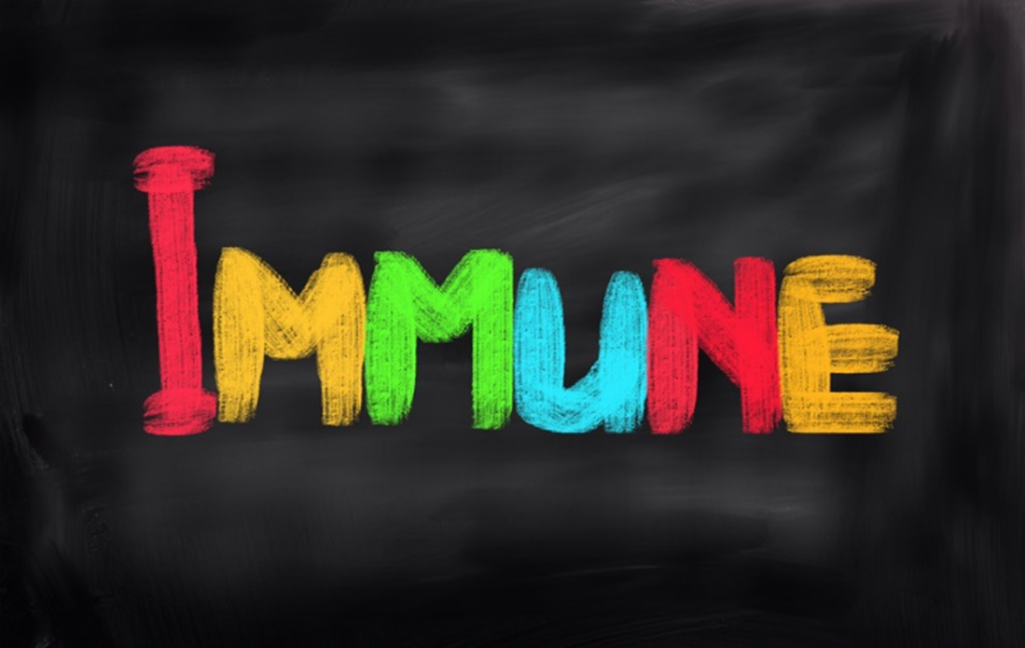
Immunity
The ability of the body to destroy and resist infection

Slide 16
Good health
Natural
Acquired
Notes:
Natural immunity is partly inherited and partly developed through healthy living.
Acquired immunity develops after overcoming a disease or from a vaccination.

Slide 17
Controlling infection

Slide 18
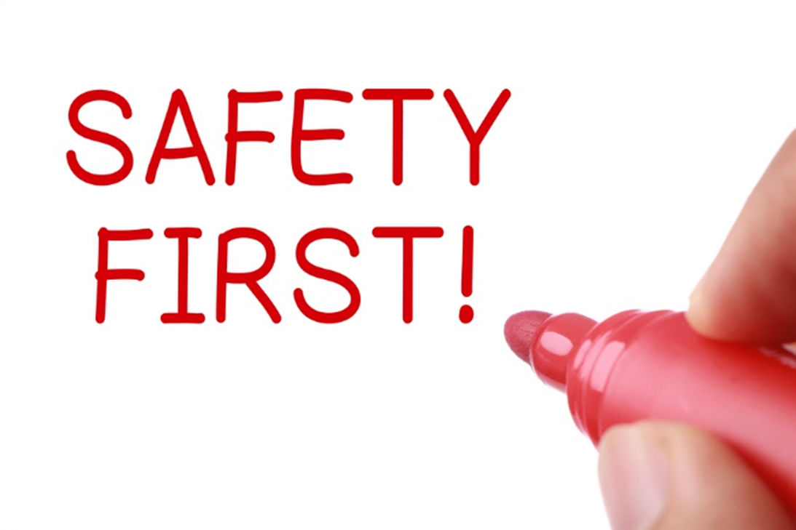
Infection
The invasion of body tissues by disease-causing pathogens
Notes:
Carelessness as a cosmetologist can cause direct injury or infection to the wellbeing of a client.
Preventing the spread of infections is easy when you follow the proper procedures daily.

Slide 19
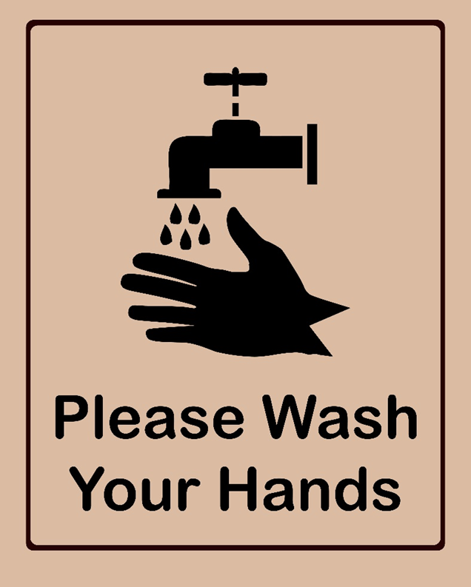
Wash your hands
Cosmetologists shall:
Wash their hands with soap and water, or use a liquid hand sanitizer, prior to performing any services on a client
Notes:
Health and Safety Standards – General Requirements.
Before beginning to work on any client, your hands must be washed first.

Slide 20
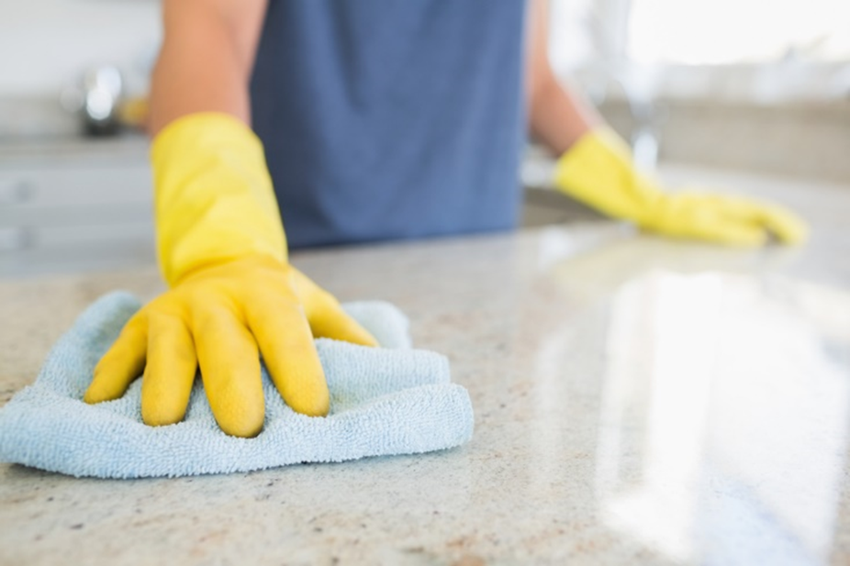
Cleaning
A mechanical process (scrubbing) using soap and water or detergent and water to remove all visible dirt, debris and many disease-causing germs from tools, implements and equipment
Notes:
Before beginning to work on any client, all work surfaces must be cleaned and disinfected.
This includes tables, stations, sinks and any area where a client’s skin may touch.

Slide 21
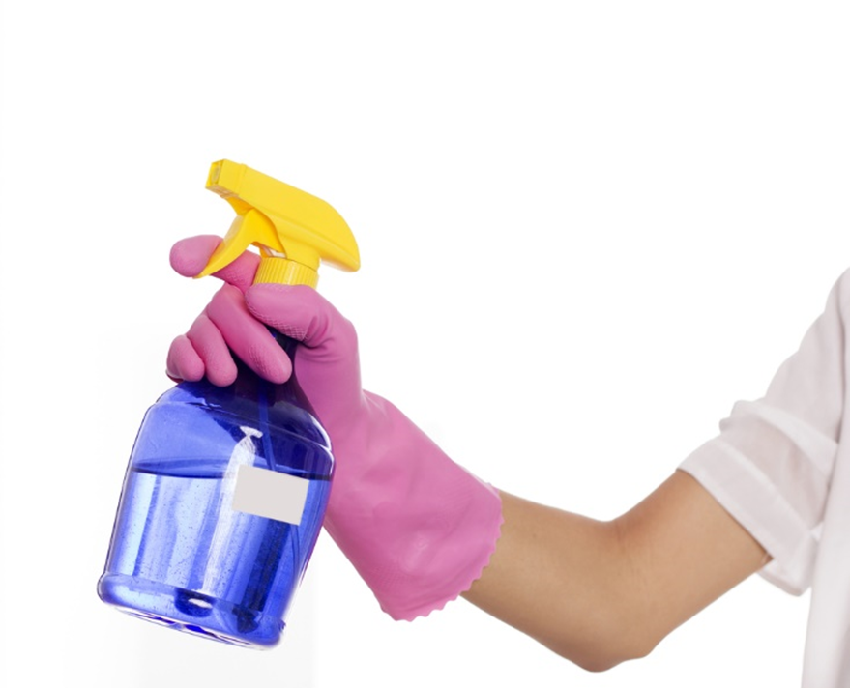
Disinfection
Destroys most, but not necessarily all, harmful organisms on environmental surfaces
Notes:
Foot spas must be cleaned and disinfected after every client and entered into a logbook.

Slide 22
Multiuse tools and implements
Must be cleaned and disinfected
Before and after every service
Mix disinfectants according to manufacturer’s directions
Notes:
Click on image to view video:
How to Establish the Disinfectant Tray
Establishing the disinfectant tray is the first operation for State Board Exam for all beauty school students, who take a test to get their license. Sanitation and disinfection operation is a separate procedure. It requires to disinfect the soiled implements of the previous operation, like haircut or color that was in the exam book before sanitation.
http://youtu.be/iqaV39GF4Hs

Slide 23
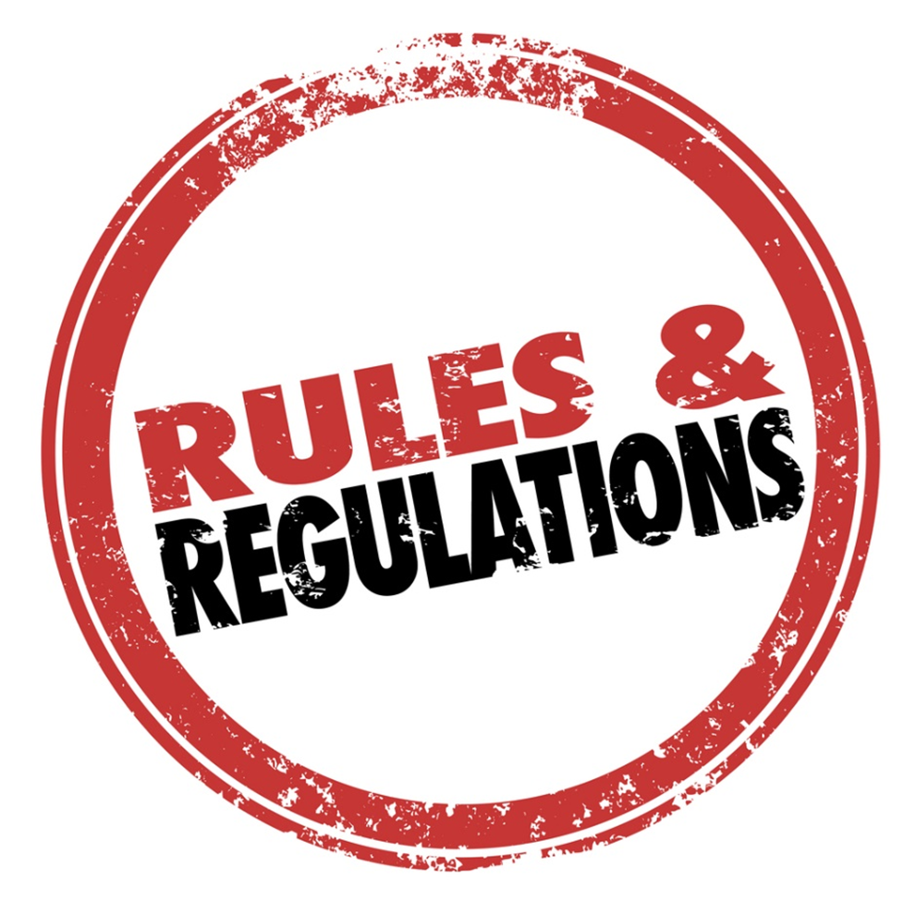
Federal Agencies
Environmental Protection Agency (EPA)
Registers all types of disinfectants sold and used in the United States
Occupational Safety and Health Administration (OSHA)
Regulates and enforces safety and health standards
Protects employees in the workplace
Notes:
Federal agencies set guidelines for the manufacturing, sale and use of equipment and chemical ingredients.
They also monitor safety in the workplace.

Slide 24
State Agency
Protects
Salon professionals
Consumers’
Health
Safety
Welfare
Texas Department of Licensing and Regulation
Cosmetologists
http://www.tdlr.texas.gov/cosmet/cosmet.htm
Notes:
The Texas Department of Licensing (TDLR) is the immediate regulator and is located in Austin, Texas.

Slide 25
Review
Where is bacteria found?
What do parasites need to survive?
What is the first step before performing work on any client?
After cleaning and disinfecting a foot spa, what must you do?
What agency protects employees in the workplace?
Notes:
Almost everywhere
A host
Wash your hands
Enter it in a logbook
OSHA

Slide 26
Questions?

Slide 27
References and Resources
Images:
Shutterstock™ images. Photos obtained with subscription. (Slides 1, 3, 4, 6, 7, 8, 9, 10, 11, 14, 15, 16, 17, 18, 19, 20, 21, 23, 25)
Textbook(s):
Milady standard cosmetology: Situational problems. (2012). Clifton Park, NY: Cengage Learning.
Videos:
Inspection Records Reveal Big Fines at Some DFW Nail Salons
Inspection records for North Texas nail salons reveal thousands of violations and hundreds of dollars in fines over unsanitary conditions and licensing issues.
http://www.nbcdfw.com/investigations/Inspection-Records-Reveal-Big-Fines-at-Some-DFW-Nail-Salons-259853151.html
Unsanitary Conditions at Nail Salons Pose Health Risk
The unsanitary conditions you don't see at your neighborhood nail salon could affect your health and safety, but knowing what to look and ask for could limit your risk of problems.

Slide 28
References and Resources
http://www.nbcdfw.com/investigations/Unsanitary-Conditions-at-Nail-Salons-Pose-Health-Risk-259998201.html
Website(s):
Health Hazards in Nail Salons
Biological Hazards
Biological hazards include bacteria, fungi, and viruses.
https://www.osha.gov/SLTC/nailsalons/biohazards.html
YouTube™:
How to Establish the Disinfectant Tray
Establishing the disinfectant tray is the first operation for State Board Exam for all beauty school students, who take a test to get their license. Sanitation and disinfection operation is a separate procedure. It requires to disinfect the soiled implements of the previous operation, like haircut or color, that was in the exam book before sanitation.
http://youtu.be/iqaV39GF4Hs

