Slide 1
The Visual Appeal of Plating Food
Notes:
It is not just important to prepare the food well, but present it in a pleasing and eye appealing manner

Slide 3
Essentials of Plating
When plating:
Cut and cook food correctly
Be neat and clean
Edges should be clean and presentable
Use artistic flare
How to Plate a Cobb Salad
http://www.5min.com/Video/How-to-Plate-CobSalad-411061983
Leads to enhanced customer satisfaction
Notes:
When we sit down to eat, we eat with our eyes first. The way we plate and present the food is
as important as the taste of the food.
The way the food is cut and cooked affects how food is plated.
Before food is served, wipe the edges of the plate so they are clean.
A key to plating is artistic flare by creating eye appeal. This will lead to enhanced customer
satisfaction.

Slide 4
Balancing Your Plate
Eye- catching
Various shapes
Mixture of textures
Excite all the senses
Notes:
Colors, cooking, textures, shape, and flavors are all factors in plating your food.
• Make your plate eye catching by adding vibrant colors
• Cooking and plating with a mixture of textures can not only be pleasing to the eye but also to
the palate
• Various shapes on your plate add contrast and variety
• While flavors cannot be seen, it is important to take into account when plating because you
want excite all the senses

Slide 5
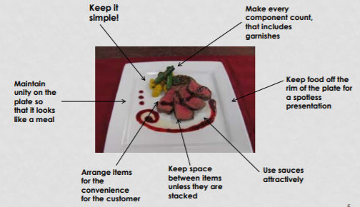
A Beautiful Arrangement
Notes:
When you are plating, remember KISS – Keep It Simple Silly!
Create your plating arrangement with an editing eye. What is really needed and what will
enhance the food you are presenting.

Slide 6
Garnishing
Whether simple or elaborate, the finishing touch on your plate is important
While many Chefs stick to a sprinkle of herbs or chocolate curls, more intricate garnishes can be made from fruits and vegetables
Notes:
When planning your dish, don’t forget to plan the garnish. Many chef’ reinforce using edible garnishes when plating food. Remember, the garnish needs to be calculated into your plate cost.

Slide 7
Questions?

Slide 8
References and Resources
Pictures:
Microsoft Office Online images
J. Gorell, FCS Teacher, Athens H.S. student competition plate for ProStart Invitational
Textbook:
Wayne Gisslen, Professional Cooking, Sixth Edition, Chapter 8, (John Wiley and Sons, 2007)
National Restaurant Foundation, Foundations of Restaurant Management, Level 2, (Pearson, Prentice Hall, 2011).
Websites:
Chef Curtis Stone on How to Plate a Cobb Salad http://www.5min.com/Video/How-to-Plate-Cob-Salad-411061983

