Slide 1
Using Student Assessment Data

Slide 3
“Assessment is today’s means of understanding how to modify tomorrow’s instruction.”
~ Carol Tomlinson
Notes:
Assessments allow the teacher to gather information about the student and the knowledge they have attained during the unit of study, semester or school year. Assessments come in all shapes and sizes and are used as a tool for educators to determine if the student learning outcomes and goals were met. If not, then it is up to the teacher to reteach the information in a new format so that students grasp the concept.

Slide 4
Process of Data
(click on image)
Notes:
Allow time for student discussion.
Process of data use – Performance-Driven Education in the Classroom
The Michael and Susan Dell Foundation explain the benefits of performance driven education in the classroom.
https://youtu.be/FYEymwPm8gw
Teacher note: More information on this topic can be found at Assessing What is Being Taught from http://cte.sfasu.edu/lesson-plans/assessing-what-is-being-taught.

Slide 5
Types of Assessments
What types of assessments can you think of?
Notes:
Allow students to brainstorm the various types of assessments.
Which is their favorite? Why? Allow for a short discussion.

Slide 6
Types of Assessments
Formative
Concept map
Short written response
Summative
Midterm exam
Final project
Notes:
Formative assessments serve as a monitoring tool to provide teachers with feedback about student academic progress. They identify student strengths and weaknesses.
Summative assessments are designed to evaluate student’s knowledge at the end of a unit of study.
Examples of Assessments:
3-2-1 cards
Clickers
Essays
Exams
Exit cards
Journal entries
KWL charts
Projects
Question and answer
Research papers
What are some examples of assessments you have had in class that are not represented?

Slide 7
Understanding Assessment Data
(click on image)
Notes:
Allow for a short discussion.
Taming the Beast: Understanding Assessment Data
The Innovation Effect: Building an Education Partnership, Episode 6 ‘Taming the Beast’: Understanding Assessment Data – CELT at Keene State College.
https://www.youtube.com/watch?t=82&v=dFpPT9AU-hQ

Slide 8
Overview of Statewide Student Assessment in Texas

Slide 9
State of Texas Assessments of Academic Readiness (STAAR®)
STAAR® is an assessment program designed to measure the extent to which students have learned and are able to apply the knowledge and skills defined in the state-mandated curriculum standards, the Texas Essential Knowledge and Skills (TEKS).
Notes:
The State of Texas Assessments of Academic Readiness, or STAAR, is the state testing program that was implemented in the 2011–2012 school year. The Texas Education Agency (TEA), in collaboration with the Texas Higher Education Coordinating Board (THECB) and Texas educators, developed the STAAR program in response to requirements set forth by the 80th and 81st Texas legislatures. STAAR is an assessment program designed to measure the extent to which students have learned and are able to apply the knowledge and skills defined in the state-mandated curriculum standards, the Texas Essential Knowledge and Skills (TEKS). Every STAAR question is directly aligned to the TEKS currently implemented for the grade/subject or course being assessed. The STAAR program includes STAAR, STAAR Spanish, STAAR L (a linguistically accommodated version), and STAAR A (an accommodated version).
STAAR includes assessments of mathematics, reading, writing, science and social studies in grades 3–8.

Slide 10
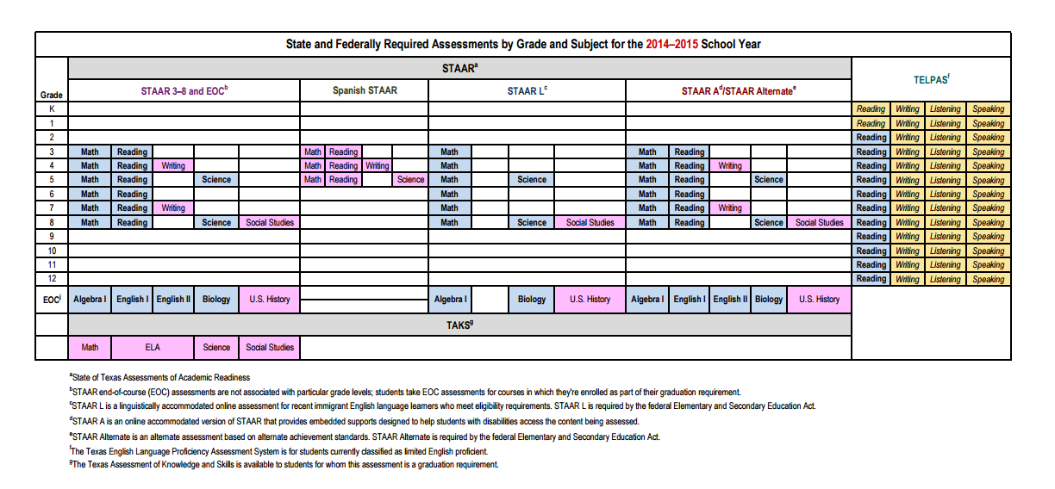
State and Federally Required Assessments
Notes:
Teacher note: You may opt to click on image to go directly to the website.
Texas Education Agency
State and federally required assessments by grade and subject for the 2014–2015 school year.
http://tea.texas.gov/student.assessment/required

Slide 11
2014 STAAR Assessments
Source: Texas Education Agency
Notes:
Teacher note: You may opt to click on image to go directly to the website. Scroll down the page until you see this section.
Texas Education Agency
State and federally required assessments by grade and subject for the 2014–2015 school year.
http://tea.texas.gov/student.assessment/staar/

Slide 12
STAAR Spanish
STAAR Spanish is provided for English Language Learners (ELLs) in grades 3–5 who meet specific participation requirements for a Spanish-version assessment.
Notes:
STAAR Spanish is provided for English Language Learners (ELLs) in grades 3–5 who meet specific participation requirements for a Spanish-version assessment.

Slide 13
STAAR Alternate
Notes:
STAAR Alternate was developed to meet the federal requirements mandated under Elementary and Secondary Education Act (ESEA). STAAR Alternate is designed for the purpose of assessing students in grades 3–8 and high school who have significant cognitive disabilities and are served by special education.

Slide 14
STAAR Modified
Notes:
STAAR Modified is an alternate assessment based on modified academic achievement standards and is intended for a small number of students receiving special education services and meet specific participation requirements.

Slide 15
STAAR L
Notes:
STAAR L is a linguistically accommodated English version of the STAAR grades 3–8 mathematics, science and social studies assessments for ELLs who meet participation requirements for particular types of linguistic accommodations.

Slide 16
Texas English Language Proficiency Assessment System (TELPAS)
Notes:
TELPAS fulfills federal requirements for assessing the English language proficiency of ELLs in kindergarten through grade 12. TELPAS assesses second language development in the domains of listening, speaking, reading, and writing. Multiple-choice assessments are used to assess reading in grades 2–12. For the other grades and domains, holistically rated assessments based on ongoing classroom observations and written student work are used. TELPAS reports student performance in terms of four English language proficiency levels: beginning, intermediate, advanced and advanced high. The TELPAS results are used in several state and federal accountability and performance-based monitoring indicators.

Slide 17
“Assessment has more to do with helping students grow than with cataloging their mistakes.”
~ Carol Ann Tomlinson
Notes:
Assessments give the teacher the opportunity to gage students’ academic success and to build on the knowledge base that they currently have.

Slide 18
How Data Helps Teachers
(click on image)
Notes:
How Data Helps Teachers
Follow a teacher and student through the school year to see how data helps teachers, parents, and others make sure students are meeting education goals. Teachers have access to more quality data than ever, on factors like student performance, attendance and more. When used along with pedagogy, content knowledge and professional judgment, these data can be used responsibly to improve outcomes for students.
https://youtu.be/cgrfiPvwDBw

Slide 19
Understanding Student Data
Source: Texas Education Agency
Notes:
Teacher note: Distribute copies of Understanding Your Child’s Confidential Student Report (CSR) to the students. They can refer to it as you are discussing the information on slides 19 and 20.

Slide 20
Understanding Student Data
Source: Texas Education Agency
Notes:
Review the different components of the CSR.

Slide 21
Tracking Student Data
Give an assessment
Grade the assessment
Record the results in a data tracking form
Use the results to direct your instructional methods
Notes:
To track student data, first you must administer an assessment, and then grade it.
Afterwards record the information in a data tracking form. There are many different types of data tracking forms to utilize. After you record the results, look over the data to determine whether or not the student(s) have mastered the goal or learning outcome you set for the student.
If the student has, you can move onto the next topic. If the student did not master the concept, then it is up to the teacher to reteach the concept in a new way to the student.

Slide 22
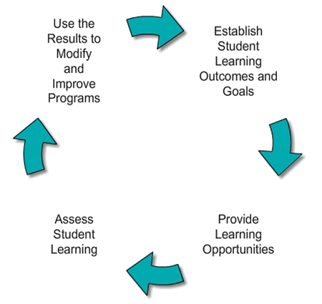
Analyzing Student Data
Notes:
Look over the results of the data collected and determine whether or not the students met the goals and learning outcomes expected. If the student has, you can move onto the next topic. If the student did not master the concept, then it is up to the teacher to reteach the concept in a new way to the student.

Slide 23
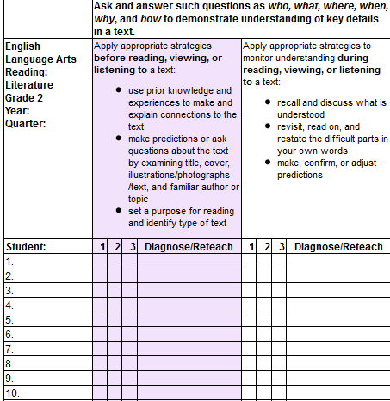
Examples of Student Data Tracking Forms
Source: School Improvement in Maryland
Notes:
Taken from School Improvement in Maryland at http://www.mdk12.org/data/progress/developing/m4w2/pr2/index.html.

Slide 24
Notes:
Item Analysis Summary Reports
Example shown: STAAR grade 4
This report shows the item number, the reporting category measured by the item, and the percentage of students selecting each possible answer choice for that test item. This summary report is provided for all students. Districts might find it helpful to use the Item Analysis Summary Report in conjunction with the 2014 released STAAR tests. For STAAR grades 3–5, English and Spanish results are reported separately.
Available:
STAAR
STAAR Spanish
STAAR Modified
A. Identification information
The top of the report contains identification information for the campus. The grade assessed, report date and assessment date are also indicated. The program logo in the upper-left corner of the summary report indicates the program.
B. Number of students tested
The number of students assessed is provided.
C. Item number
The item number corresponds to the item number on the test for that subject.
D. Reporting Category
The number of the reporting category measured by each test item is listed. An abbreviated listing of reporting categories can be found on the Summary Report. The complete wording of each reporting category for every assessment is found on TEA’s Student Assessment Division website.
E. Percent responding
The percentage of students responding to each answer choice is shown for each test item. The correct answer is indicated by an asterisk. To maintain student confidentiality, no data are reported if fewer than five students were assessed.
F. Percent not responding
The percentage of students who did not respond to this item is shown in the column with the double-asterisk heading. To maintain student confidentiality, no data are reported if fewer than five students were assessed.
G. Process number
The process number found in the bottom-right corner of the report is a unique number, per administration, that is assigned to the report by the testing contractor. Refer to this number if questions arise about the report.

Slide 25
How Do Teachers Use Data?
(click on image)
Notes:
Allow for a short discussion on how teachers use student data in the classroom.
Then, click the link above.
How does teacher use of student assessment data change student outcomes? NATD asked educational professionals the following question “How does teacher use of student assessment data change student outcomes?” https://www.youtube.com/watch?v=lkoBQeWCGDc

Slide 26
The Key to Educational Improvement: Data and How We Use It
(click on image)
Notes:
Click the link above to view the TED Talk.
What are educators responsibilities in using student data? Allow time for class discussion.
TEDxCincy – Jeff Edmondson – The Key to Educational Improvement: Data and How We Use It Jeff Edmondson suggests that student data matters, and it matters how educators utilize it in the classroom. https://www.youtube.com/watch?v=FLqc_9VxfCE

Slide 27
Questions?

Slide 28
References and Resources
Images:
Microsoft Office Clip Art: Used with permission from Microsoft™. (Slides 1, 5, and 17)
Photos obtained through a license with Shutterstock.com™. (Slides 4, 7, 8, 13, 14, 15, 16, 18, 25, 26 and 27)
School Improvement in Maryland. (Slide 23)
Texas Education Agency. (Slides 10, 11, 19, 20 and 24)
Websites:
Butte County Office of Education Using Classroom Data to Improve Student Achievement http://www.classroomdata.org/index.cfm?page=2
Carnegie Mellon Eberly Center for Teaching Excellence and Educational Innovation How to Assess Students’ Learning and Performance http://www.cmu.edu/teaching/assessment/assesslearning/
Cornell University Center for Teaching Excellence Assessing Student Learning http://www.cte.cornell.edu/teaching-ideas/assessing-student-learning/index.html

Slide 29
References and Resources
YouTube™:
How Data Help Teachers
Follow a teacher and student through the school year to see how data help teachers,
parents and others make sure students are meeting education goals. Teachers have
access to more quality data than ever, on factors like student performance, attendance,
and more. When used along with pedagogy, content knowledge and professional
judgment, these data can be used responsibly to improve outcomes for students.
https://youtu.be/cgrfiPvwDBw
How does teacher use of student assessment data change student outcomes?
NATD asked educational professionals the following question “How does teacher use of
student assessment data change student outcomes?”
https://www.youtube.com/watch?v=lkoBQeWCGDc

Slide 30
References and Resources
YouTube™:
Process of data use – Performance-Driven Education in the Classroom
The Michael and Susan Dell Foundation explain the benefits of performance driven
education in the classroom.
https://youtu.be/FYEymwPm8gw
Taming the Beast: Understanding Assessment Data
The Innovation Effect: Building an Education Partnership, Episode 6 ‘Taming the Beast’:
Understanding Assessment Data – CELT at Keene State College.
https://www.youtube.com/watch?t=82&v=dFpPT9AU-hQ
TEDxCincy – Jeff Edmondson – The Key to Educational Improvement: Data and How We Use It
Jeff Edmondson suggests that student data matters, and it matters how educators utilize
it in the classroom. https://www.youtube.com/watch?v=FLqc_9VxfCE

